Slide 1
Project 2
<Small Sudoku>
CSC 5 - 48102
Professor: Mark Lehr
Student: Weikang Du

Slide 2
Project Content Menu
Introduction
Code Summary
Psudo Code
Flowchart and Reference
Game Play (Sample I/O)
Program Code

Slide 3

1. Introduction
The small sudoku game is a logical number game, the player need to fill out
all the blank of 3X3 chart by using 1-9, each number is only able to use once.
Player need to finish this chart and make the sum of number in each row and each
column equal 15 to get the basic winning. The perfect solution is that the sum of each
slant equal 15 and based on basic winning.
In the game process, firstly, there will display a 3X3 chart with a random number
between 1-9 in random place, then the player is able to fill one number each time, and
also the player can clear one position each time after one move.
Furthermore, this game is a version of alpha, therefore, we have 10 registered ID for
tester. Player need to enter in the valid ID to start the game. And the result will export to a
record file.
2. Code Summary
Total line of code : 573
Comment line : about 117
Number of variables: 15
Number of function: 13
Back Menu

Slide 4
Constructs
Do while loop | line 96, 109, 263
While loop | line 82, 87, 119, 129, 143, 202, 408, 415, 472, 516, 541
If | line 160, 163, 268, 295, 320, 321, 356, 379, 382, 448, 452, 494, 564, 568
If else | line 63, 151, 152, 170, 265, 566
Switch Case | line 184, 195
For loop | line 67, 159, 161, 290, 294, 345, 350, 377, 378, 446, 447, 563, 565
File and random
Srand | line 44
Rand | line 103, 104, 107
Ifstream | line 51
Ofstream | line 50
Open( ) | line 60, 61
Close( ) | line 72, 211
Back Menu

Slide 5
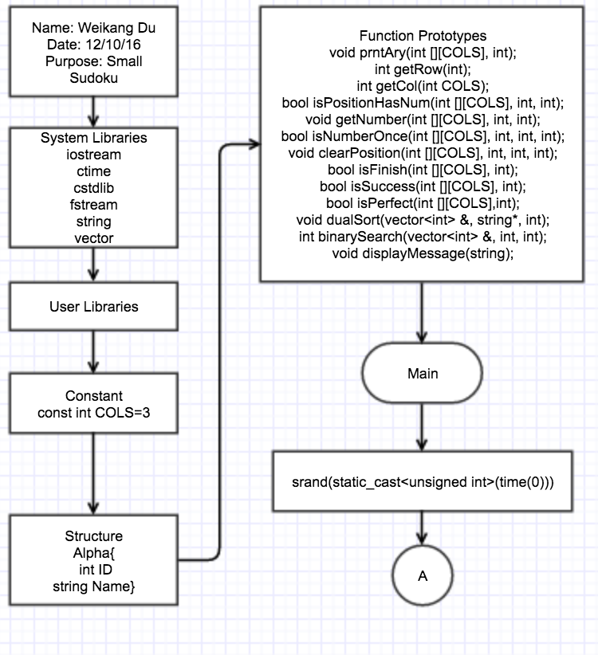
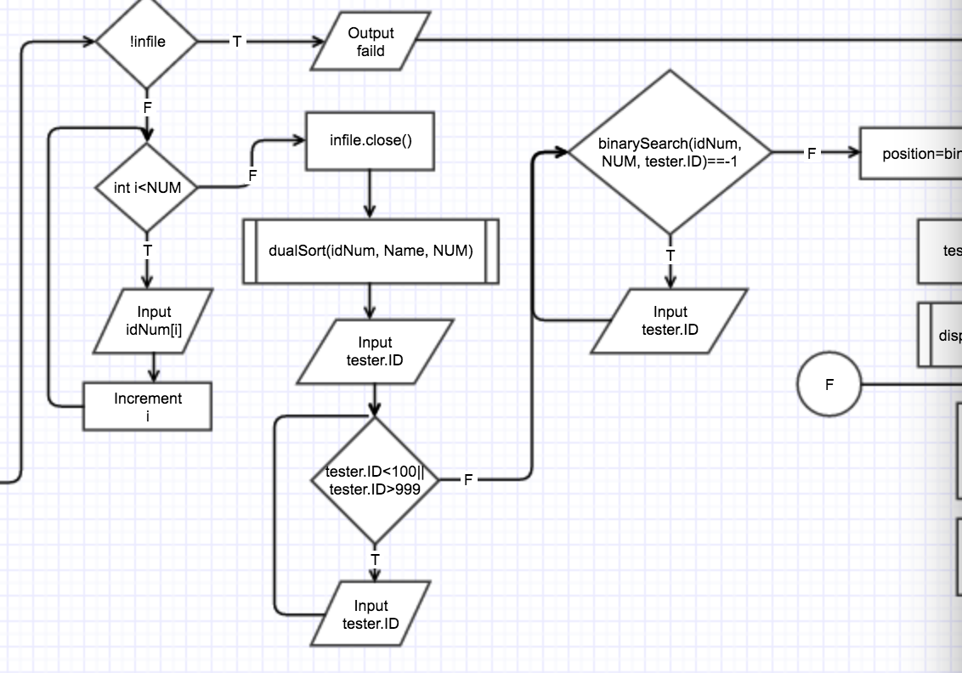
3. Psudo Code
Opening comment and declare the
system libraries. Set the constant int number
for column size of the array. Declare a structure
for tester’s information. And then function
prototypes. And main function begin, then set
the random seed immediately.
At here, open the file, and using for loop, to get in all id
number and storage in idNum array. then close the file
Declare all variables, then open the file for output
and read. Verify opening or not. Let the player enter
in the id, then do the dual sorting for integer number id
array and parallel name array. Then valid the id and do
the binary search to get the position of this id.
Back Menu

Slide 6
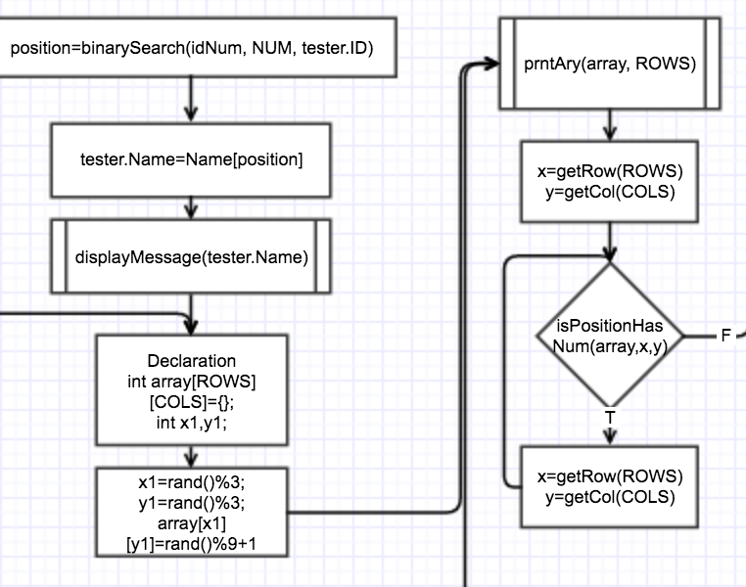
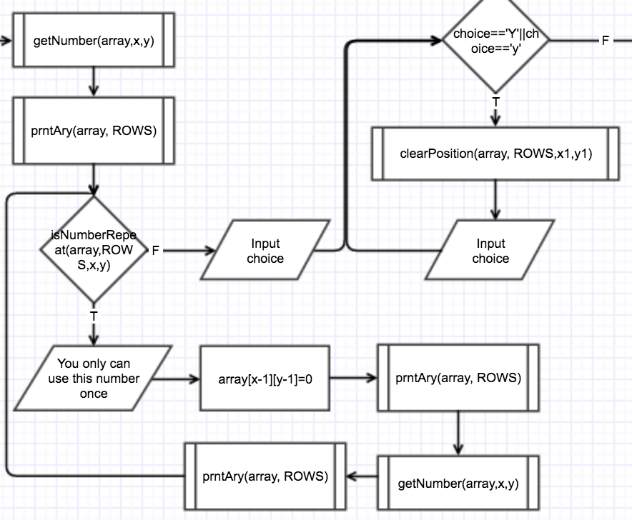
Plug the position in the name array, and pass it to
displayMessage function.
Set the answer array is null. Random a position with a random
number between 1-9.
Then display the output. Using the function
get the position which the user want to put number in.
Valid the position, if there already has a number, player
can not enter in a number in this position.
If not, then input a number and display the output
valid the number repeat or not. if it dose, then clear it
and display, then input another number and display
in a loop.
Until the number is once, user can get a chance to
decide to clear one position each time or not in a while loop.
if the player want to clear, then call the clearPosition function
Back Menu

Slide 7
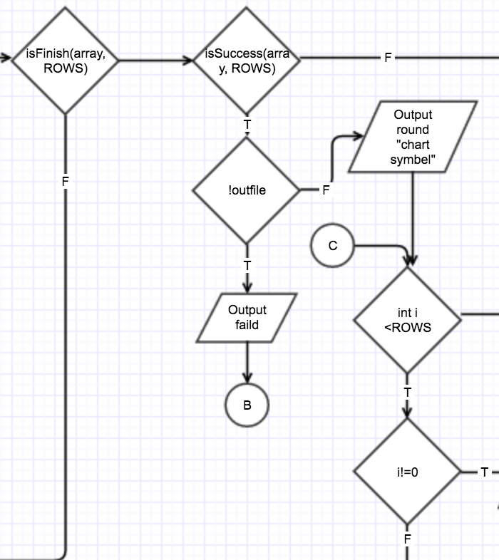
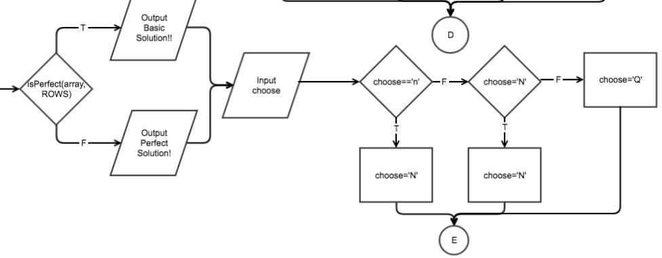
Then call function isFinish function determine the game
is finish or not. if not, then using the while loop continue to
above get position, get number etc..
if it is finished, then call function check success or not.
For success, check the file opening or not,
and display the answer array.
Then call function check it perfect solution or not
output the result. Then the program ask the choice and
switch case formatting the choice. if choice is N, in a
while loop, will go to above set the array is null. if not
then return 0 and exit the program.
Back Menu

Slide 8
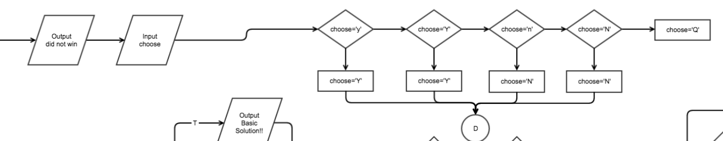
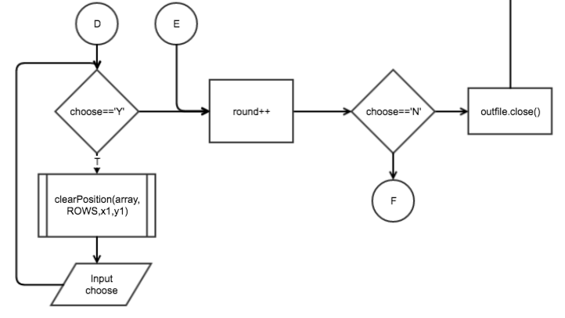
If not win, output the result, then ask for choice, by using switch case formatting the choice.
At here, player can go back to clear one position each time, and redo it. Or start a new round in
while loop.
And also can default choice to quit the game.
If the while loop finish,
then close the file for output
Back Menu

Slide 9
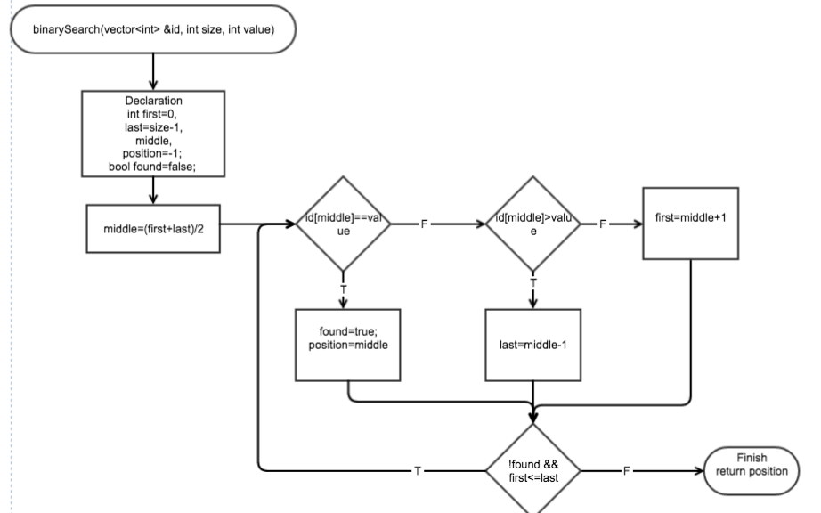
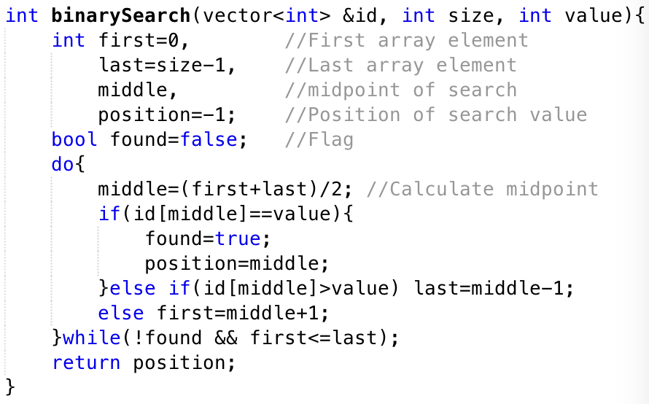
binarySearch
Receive the integer vector id and its
size and value for search.
set the initial first and last position.
set the found false flag.
then using do while get its middle position.
compare middle value with searching value.
if it is, then true flag, and position is middle.
if not, then check middle value greater than
searching value or not.
if it dose, then last=middle-1
if not, then first=middle+1
the condition for loop is searching until the value
is found or first<=last. No element to search.
then return the position.
Set the initial position -1,
when the value is not found,
in the main function can recognize -1
then display it is not found in data.
Back Menu

Slide 10
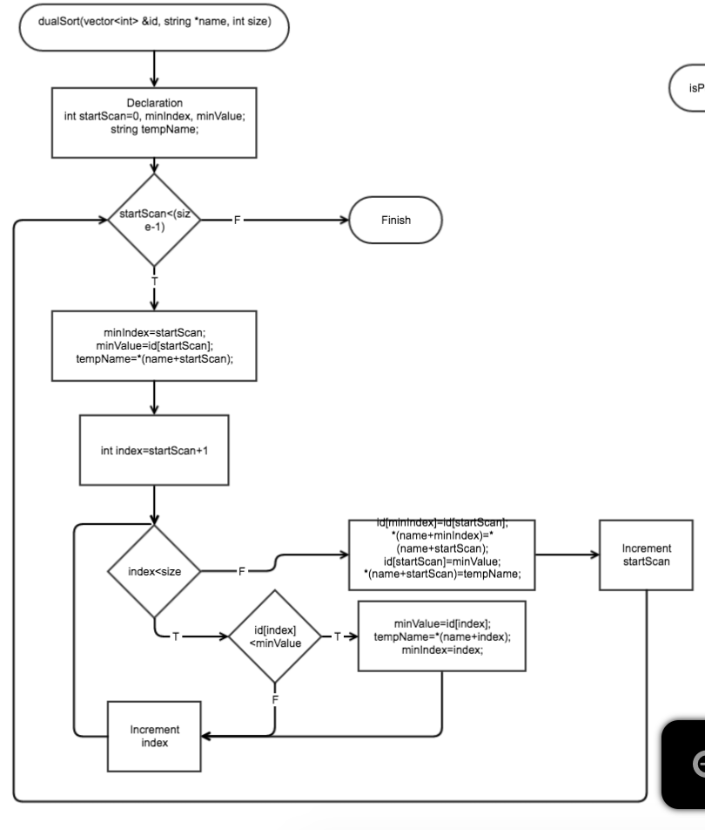
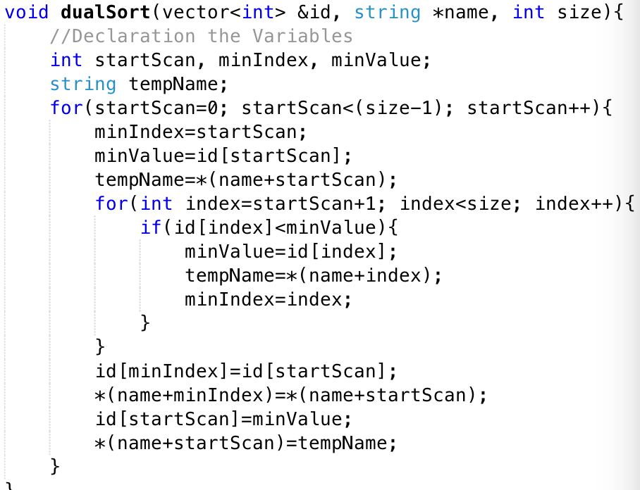
dualSort
Receive the integer vector id and string name and their
size.
Declare the date type. And using for loop.
set minIndex is the position declare in loop begin with 0
minValue is the value in position startScan.
tempName is name in array at position startScan
then using another for loop to compare the id number
with later one. if later one smaller, then swap them.
until get the smallest one and move it to first.
then do same thing for second one, etc..
Back Menu

Slide 11
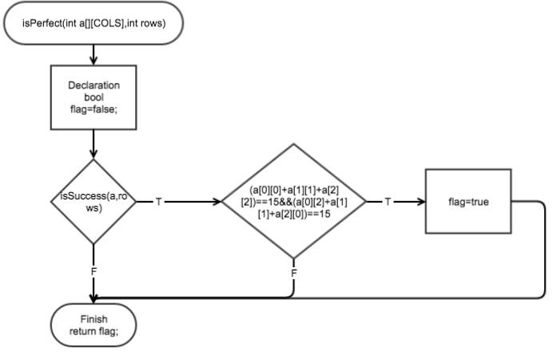
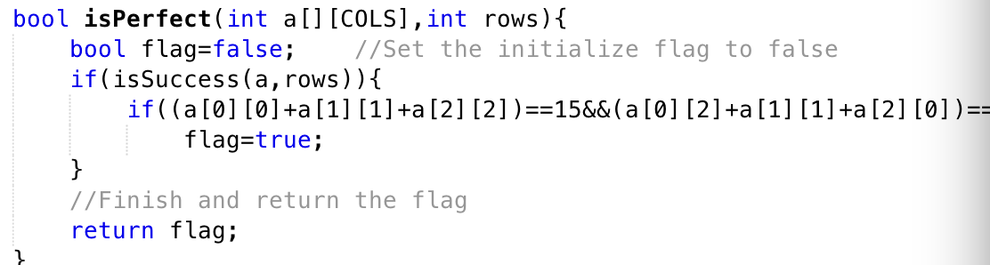
isPerfect
set the boolean flag false, then using if statement
verify the answer is success or not, based on the answer is finish
if not finish just return the false flag
it dose, then do below
if each slash in array is equal 15 at same time,
then set flag to true. And return the flag
Back Menu

Slide 12
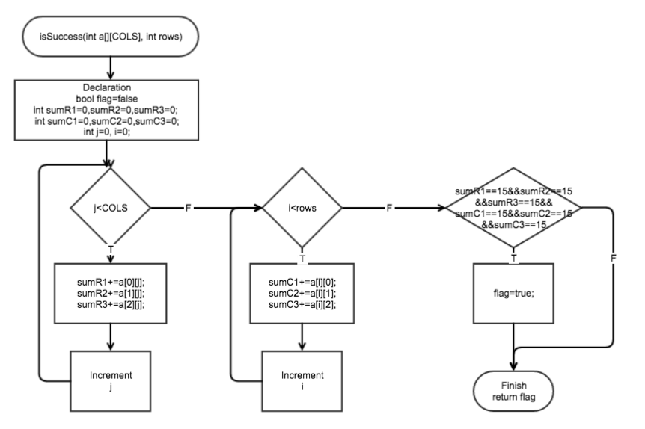
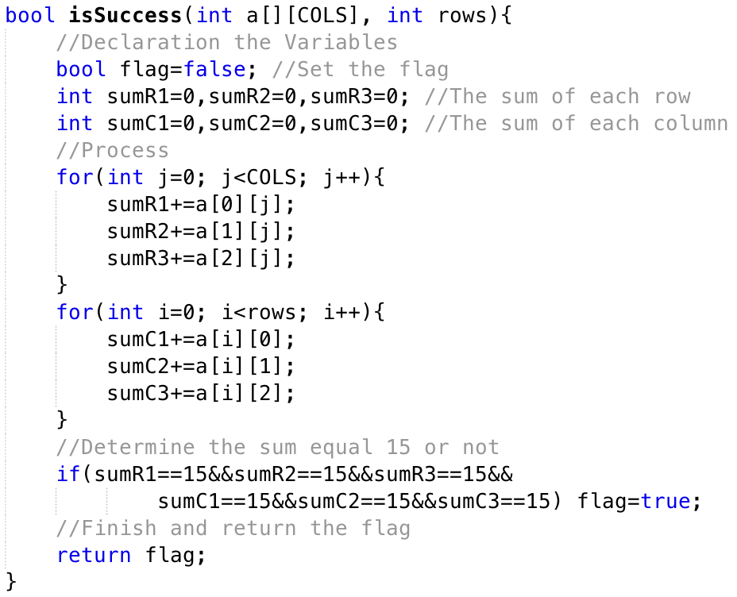
isSuccess
Set the initial flag to false, then declare sum of each row and each column
then get the sum of that by using two for loop.
then determine that each sum equal 15 or not. the relationship between them is and.
Therefore, it must all of sum equal 15 at same time.
For anyone is not 15, then the flag is false, the answer is not correct.
then return the flag to main function,
Back Menu

Slide 13
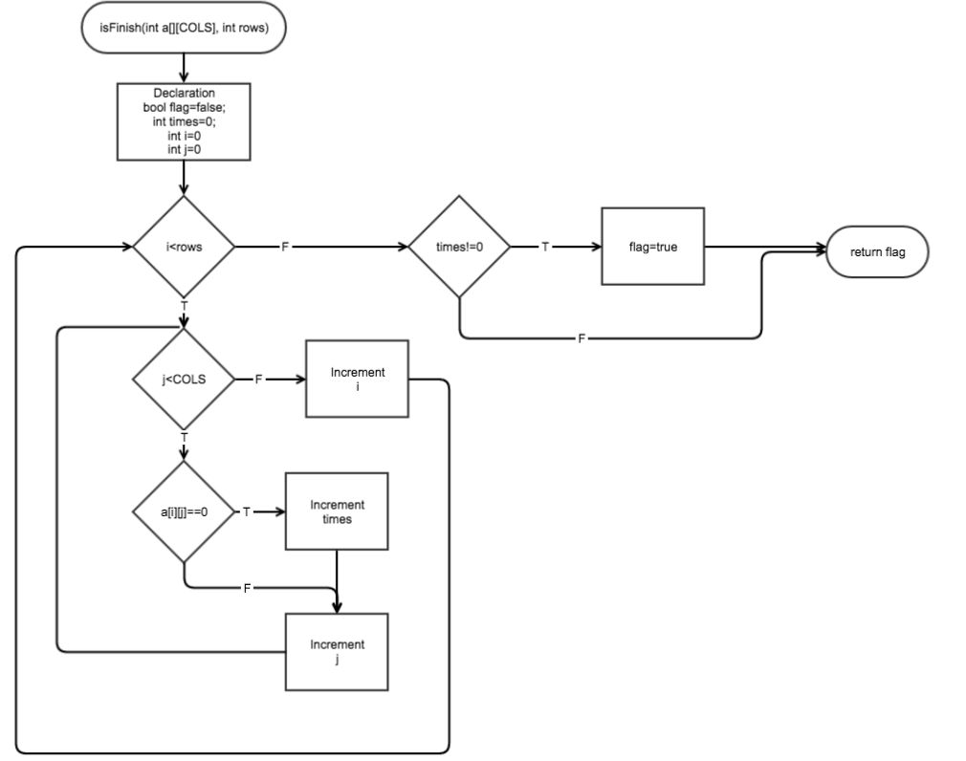
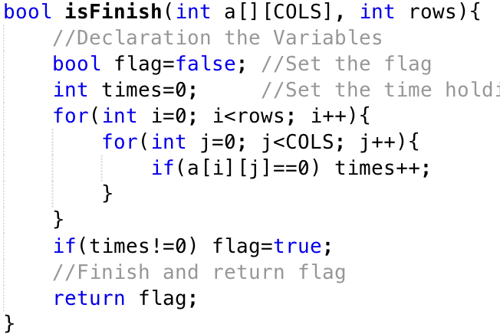
isFinish
this function receive the answer
array, and its row size.
Then the function will check that all blank
is fill out or not.
set the boolean flag to false. then declare
times 0. use two for loop check each position
if there exit 0 then increment times.
then use the if statement
if the times not equal 0
that means there still have 0 in array
is not finish
and return flag to main
main function if - statement !(isfinish)
Back Menu

Slide 14
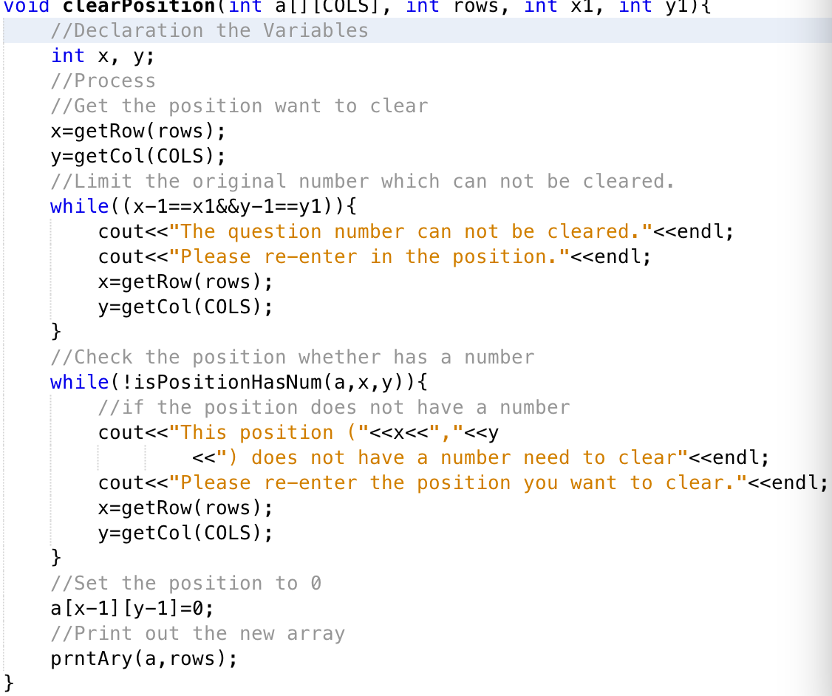
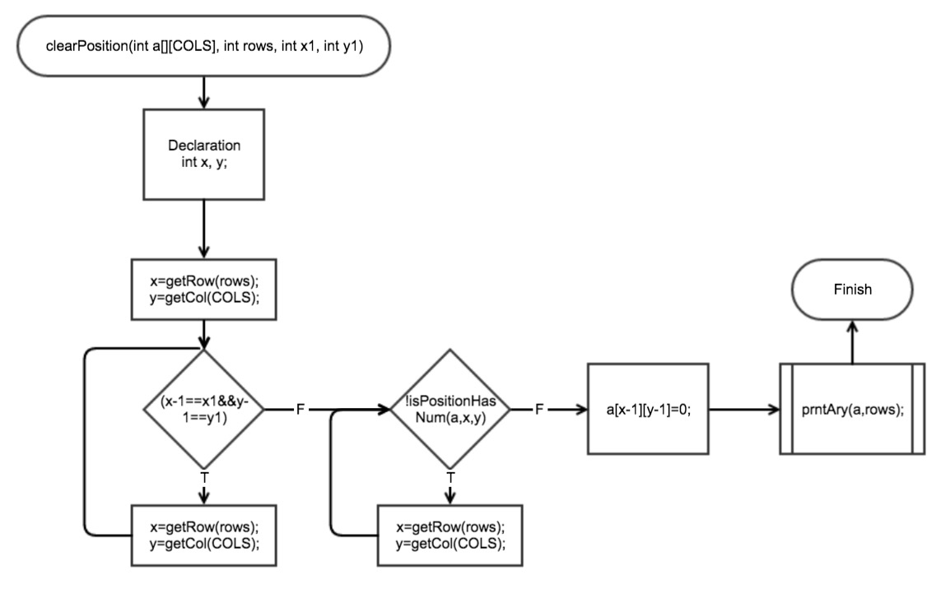
clearPosition
The function clearPosition will receives answer array, its row size and the position.
then get the position the player want to clear. Determine that the position is not the original
one. if it same as original then get the do while loop to re-enter in a position.
then call the function isPositionHasNum, if has a number then set this position 0,
if not have a number , re-enter a position.
Finally, print out the array for display.
Back Menu

Slide 15
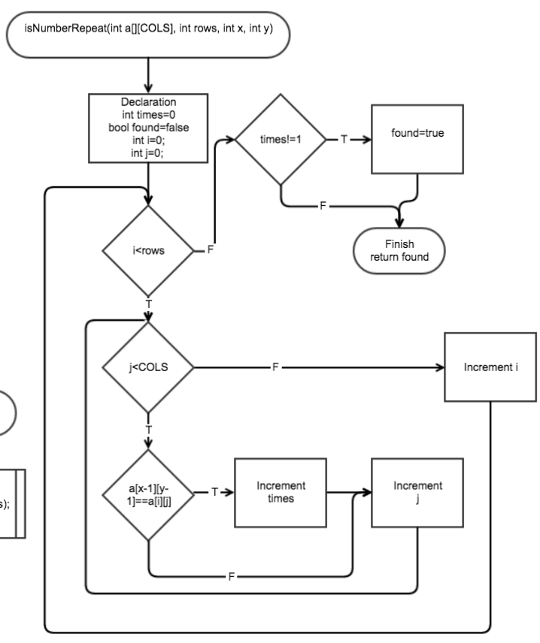
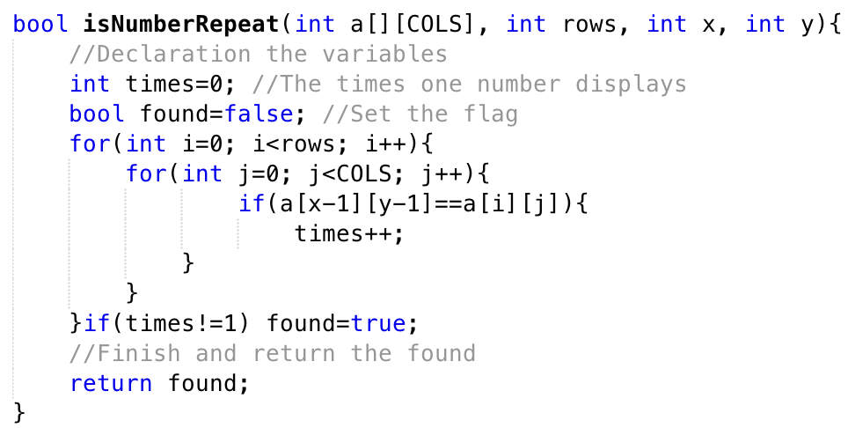
isNumberRepeat
This function will check the number which the player
enter in is only using once or not.
Receive the array, its row size and position,
then, set the initial found= false.
declare the times=0. use two for loop check each
position. if this number the user enter in equal to any
element in the array. then increment the times.
finally, use the if statement determine time!=1.
if time not equal 1 then change found to true.
For the number enter in, this array is already has times=1. if there are two or more number same as
the number user enter in, then increment the times. the times will greater than1. then flag=true.
it means this number is repeat.
Back Menu

Slide 16
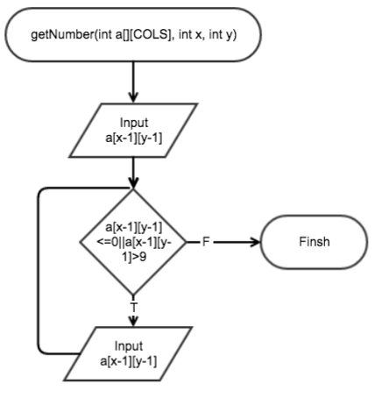
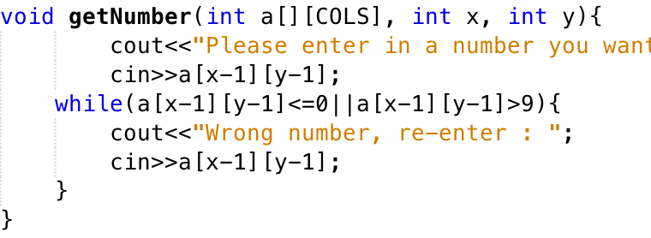
getNumber
The function get number will receive the array and position
then let the player enter in a number. Valid the number between
1-9 by using while loop.
Back Menu

Slide 17
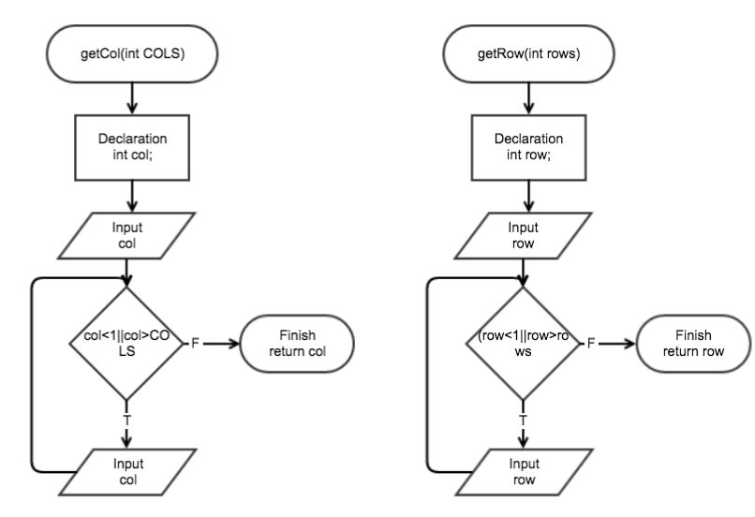
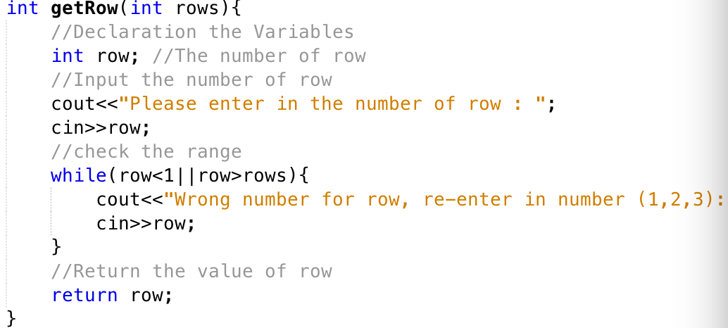
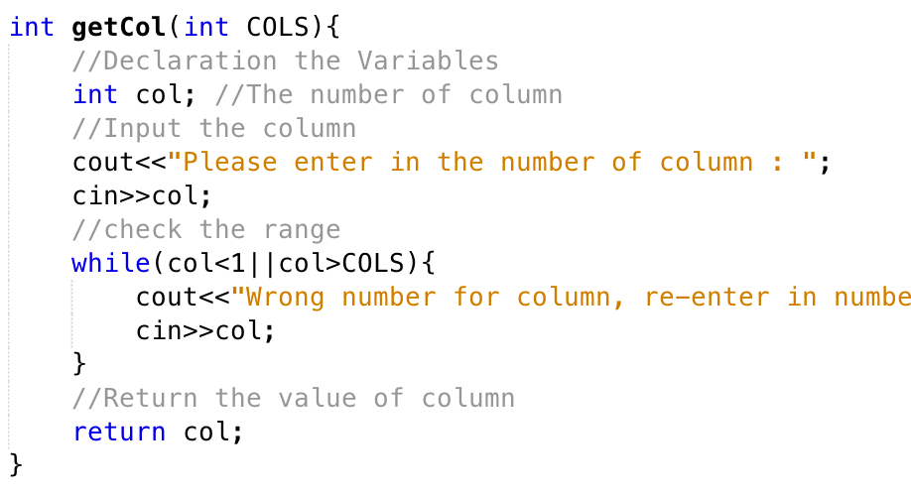
There are two function for getting in a position
I set the position formatting like (row, column)
then use while loop get the row and column.
valid the number between 1-3.
then finish and return the position.
(return the column and row)
Back Menu

Slide 18
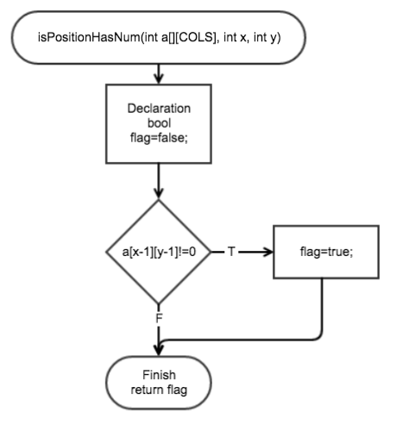
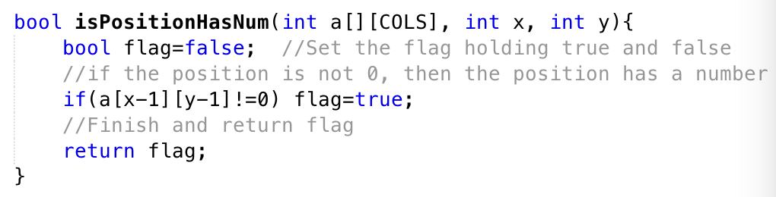
isPositionHasNum
the function isPositionHasNum receive the array and position,
then set the initial flag to false.
use if statement for check the position value equal 0 or not.
b/c I set the array is null. so expect the original one, other place
the user didn’t enter in should be 0.
so if the position value is 0, it means the position is no num.
if there not 0, then set the flag=true. return the flag to main function
Back Menu

Slide 19
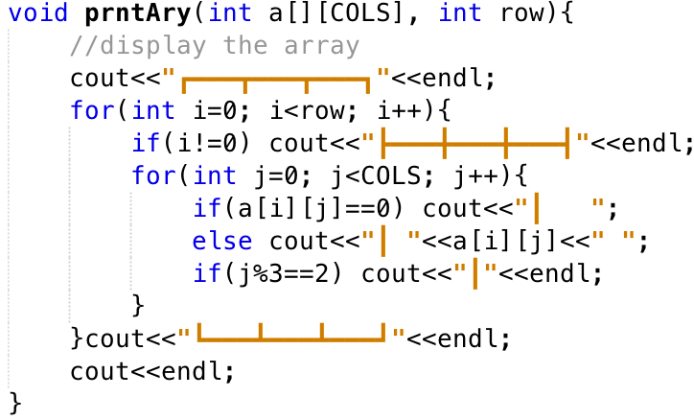
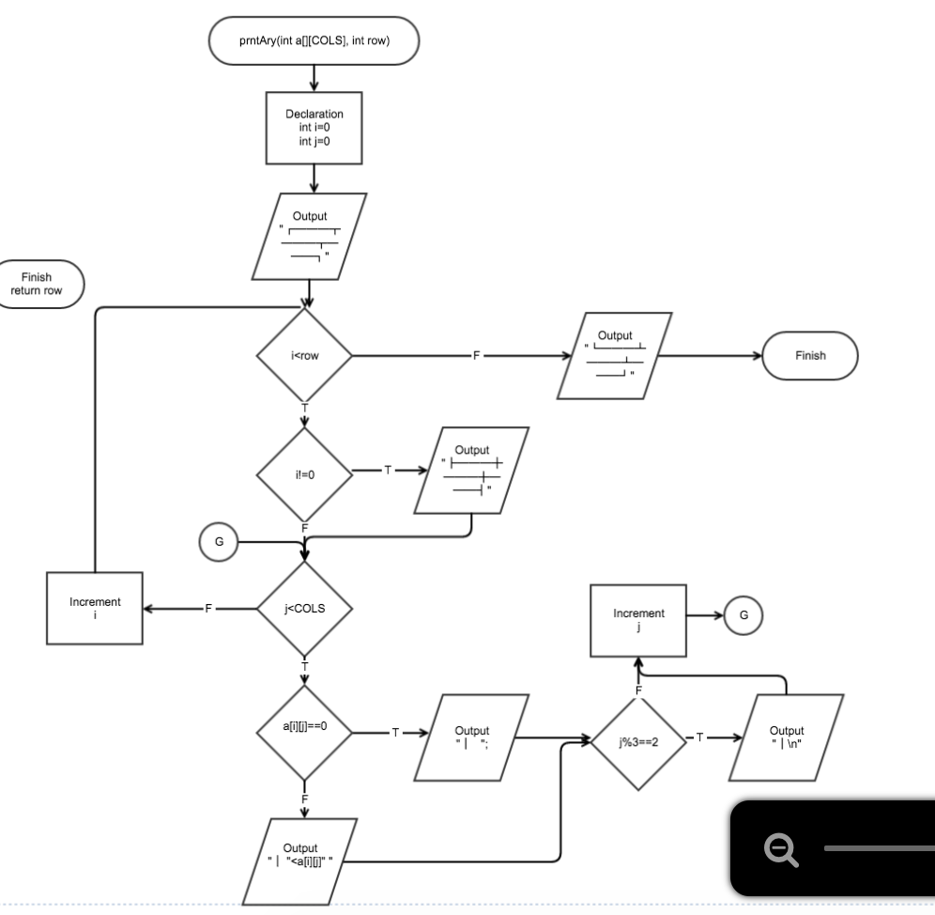
prntAry
The function prntAry main display the answer
array and the chart.
Firstly, output the header.
then use for loop to loop each row.
if row not equal 0, cout the middle chart.
then use another for loop to loop each column.
if the position has no number then display a blank
if the position has a number then display the number
finally, display the footer.
Back Menu

Slide 20
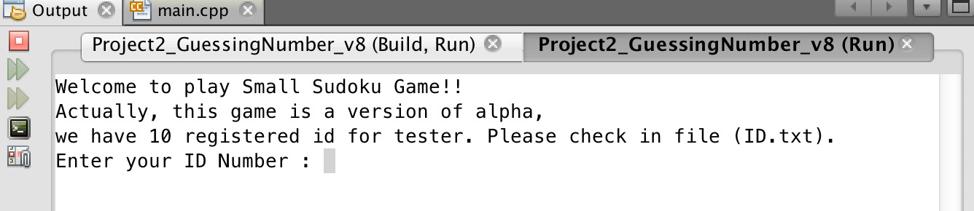
4. Flowchart and Reference
Flowchart:
Click for Project 2 Flowchart
( by using gliffy.com )
Reference:
Gaddis 8th Edition.
Github of Professor Mark lehr
5. Game Play (Sample I/O)
Back Menu

Slide 21
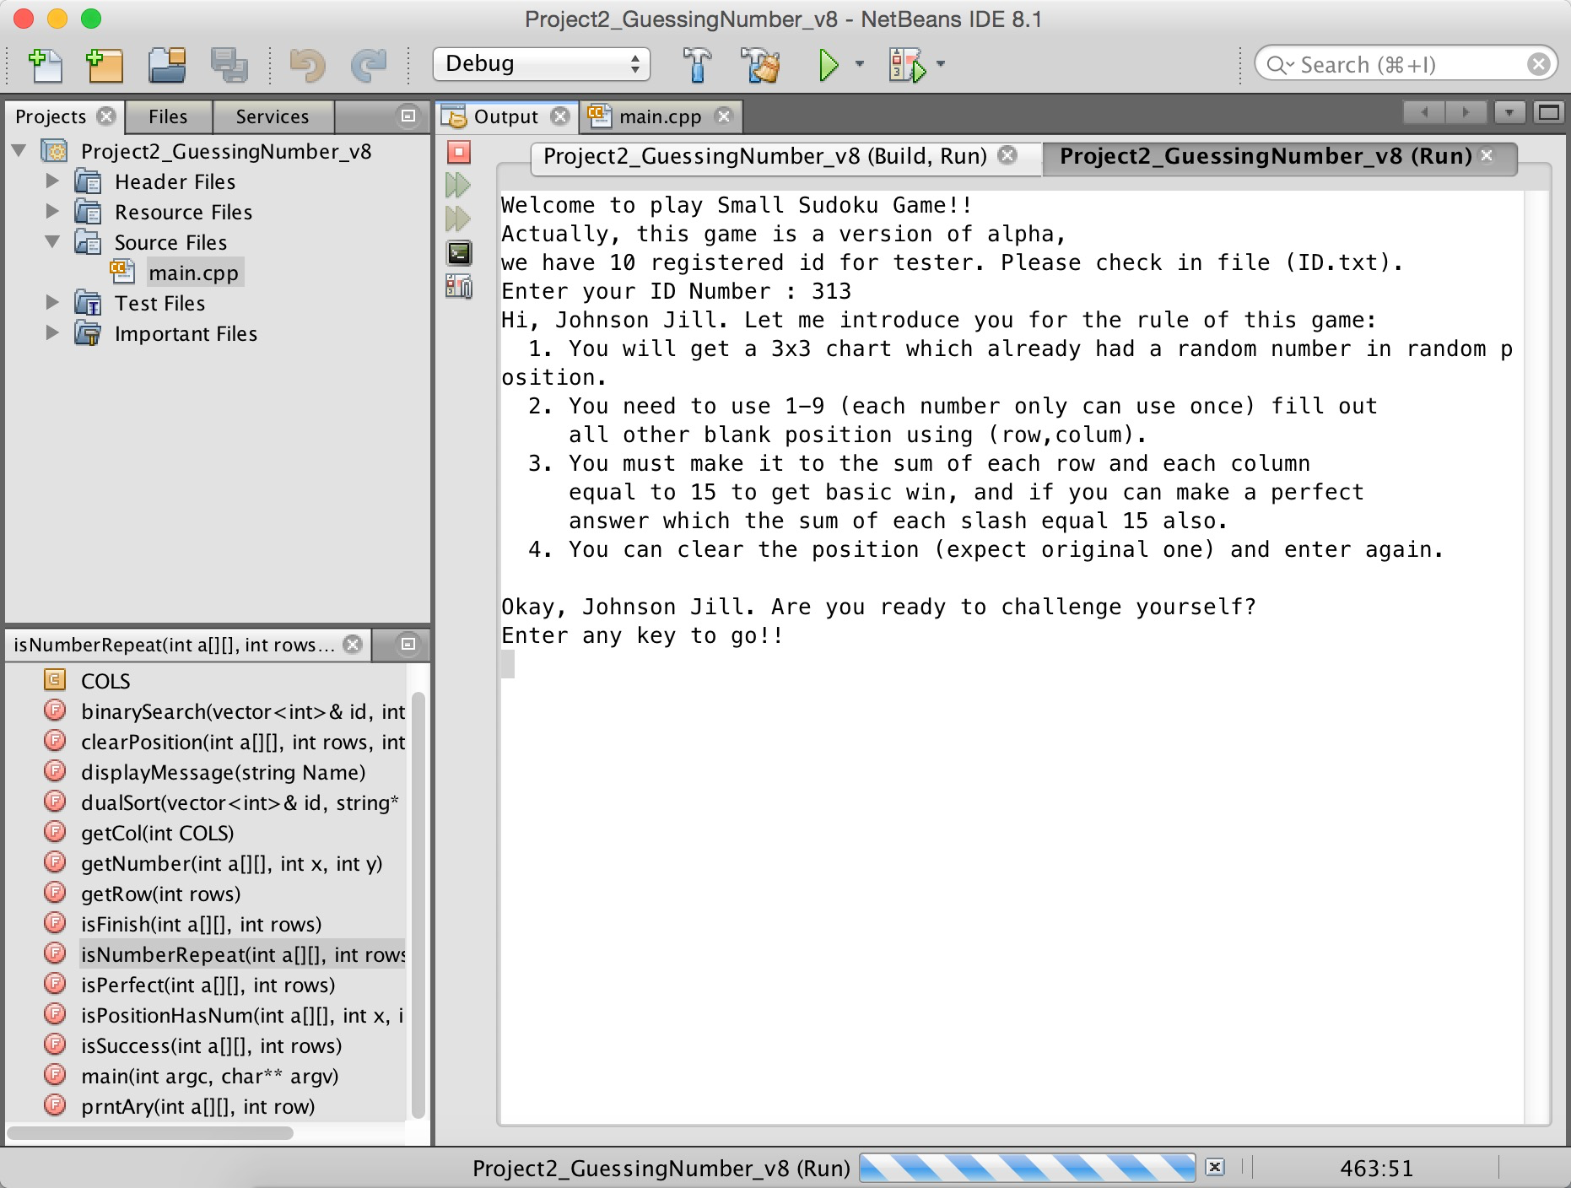
Back Menu

Slide 22
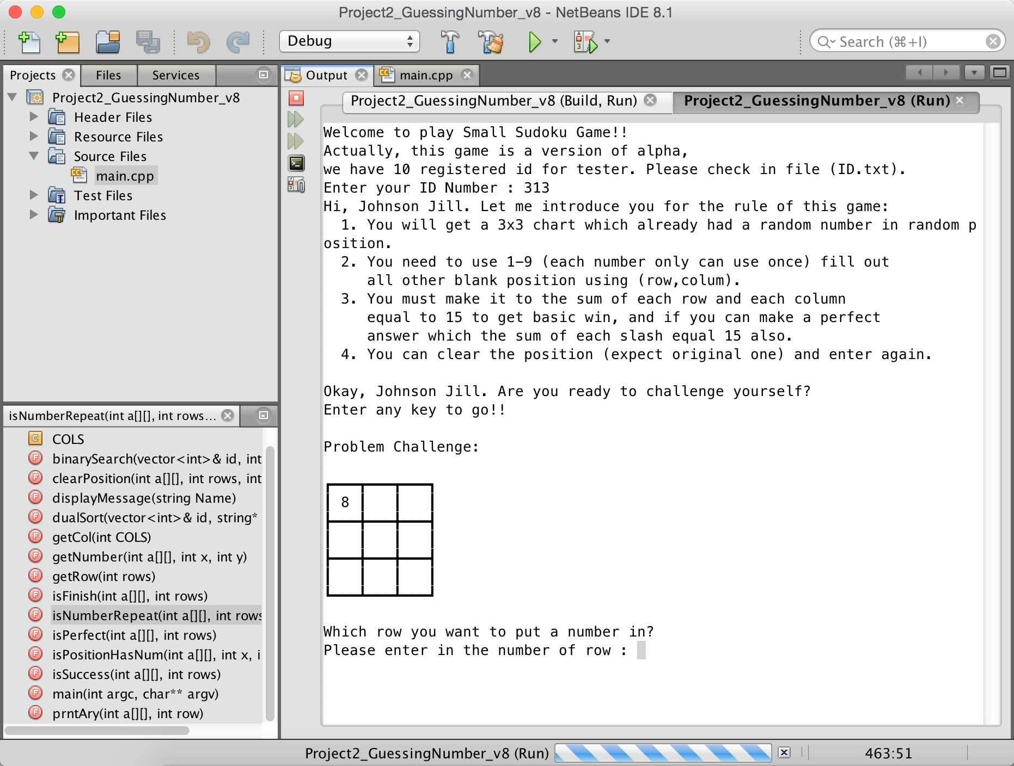
<- Here is the original number in question
Back Menu

Slide 23
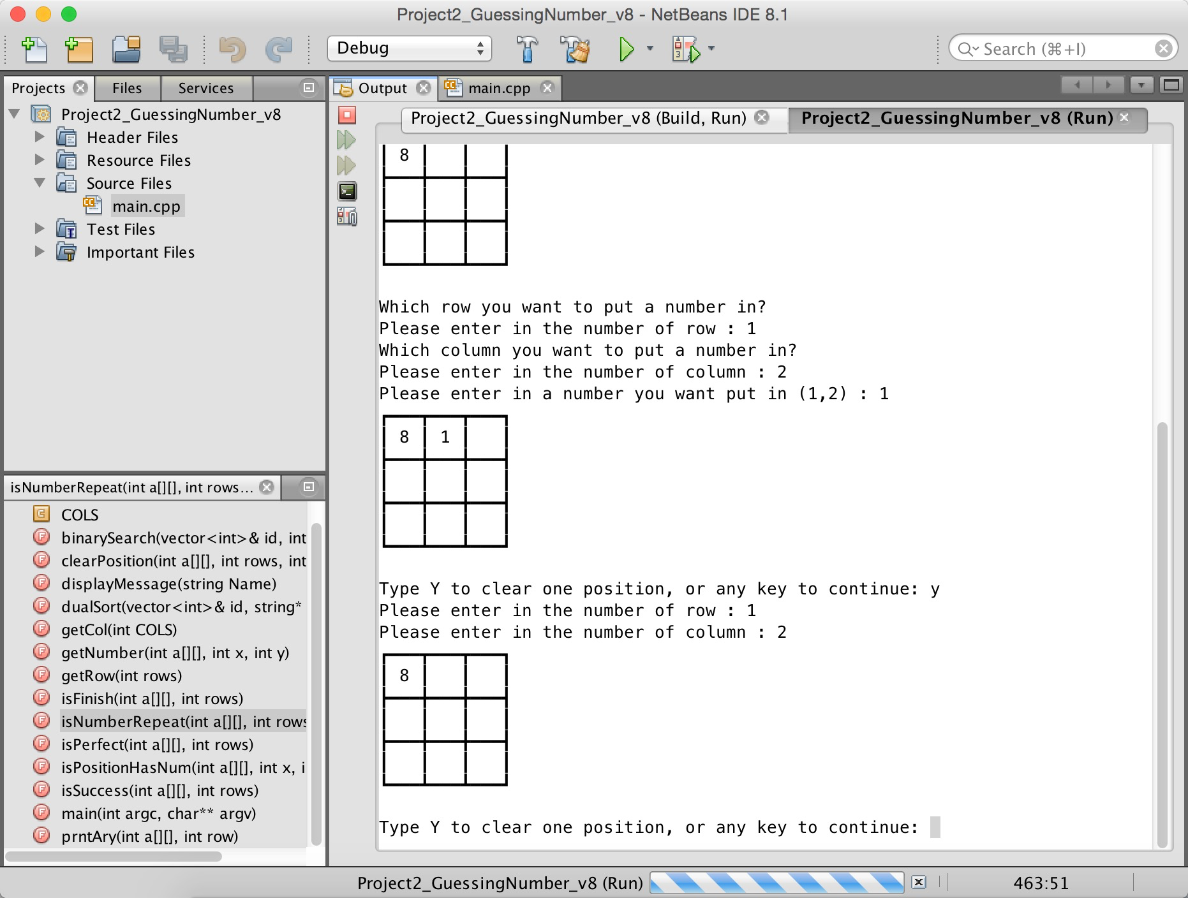
<- enter the position
<- enter the value
<- for clear the position
Back Menu

Slide 24
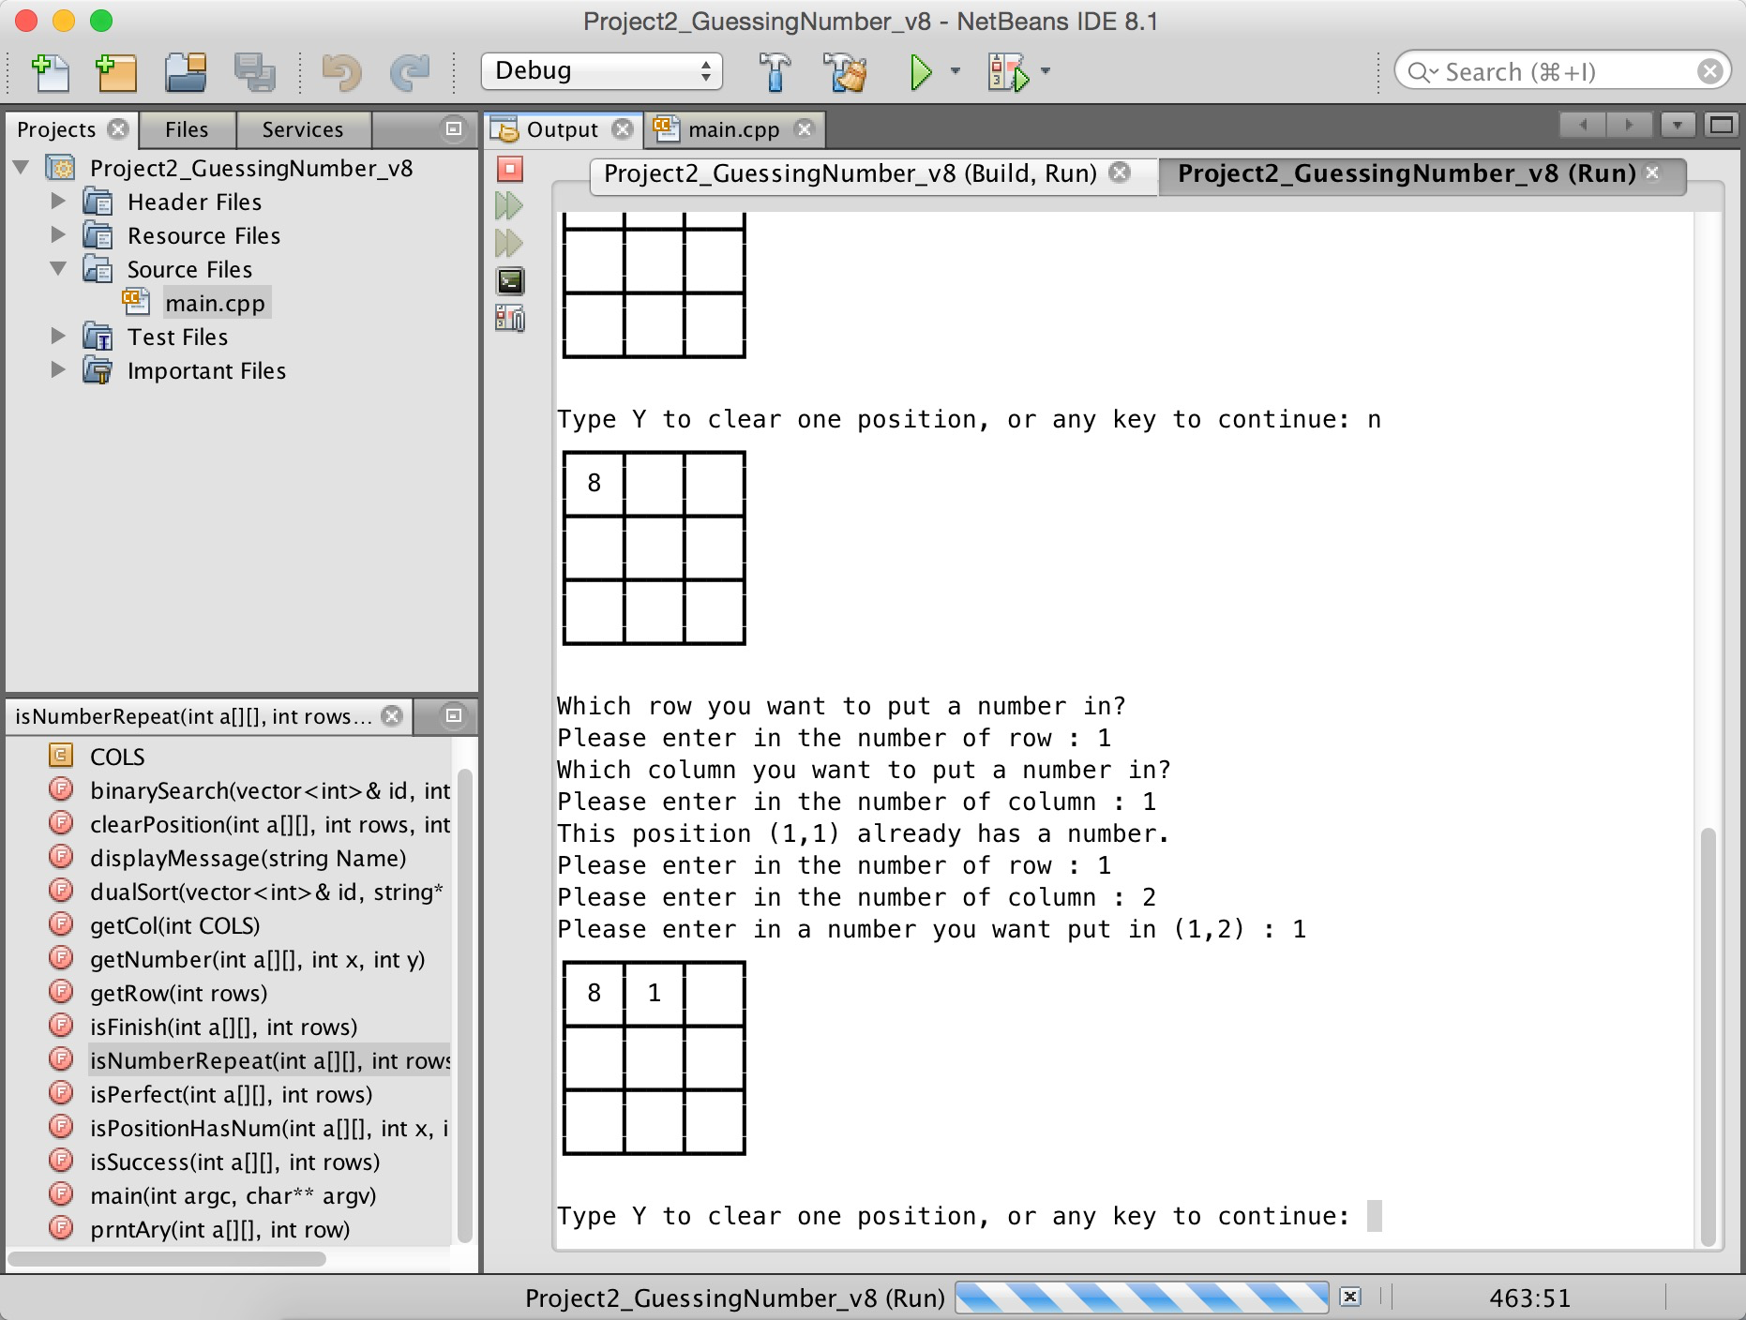
<- The player can not enter
the position which
already has a number
Back Menu

Slide 25
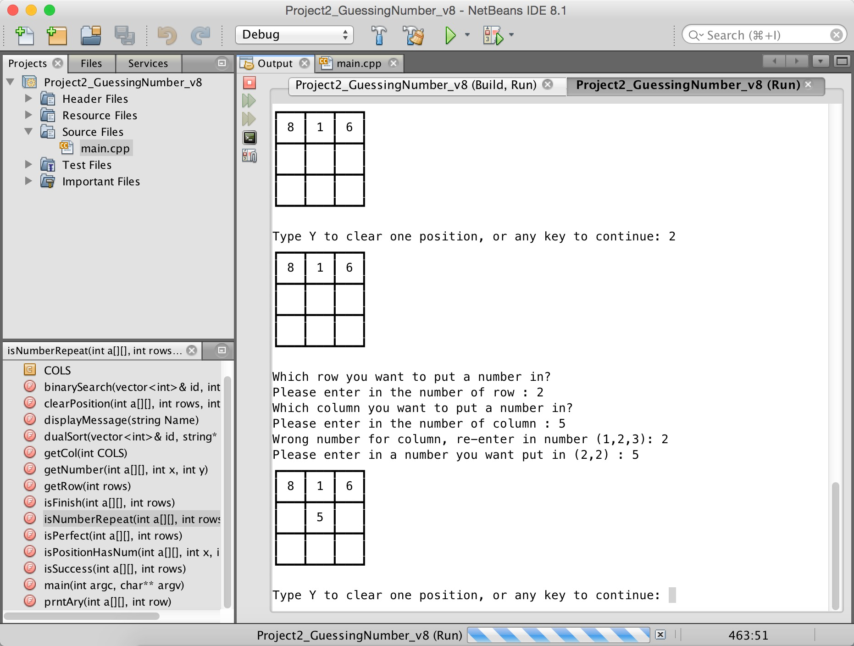
<- The row and column must
between 1-3
Back Menu

Slide 26
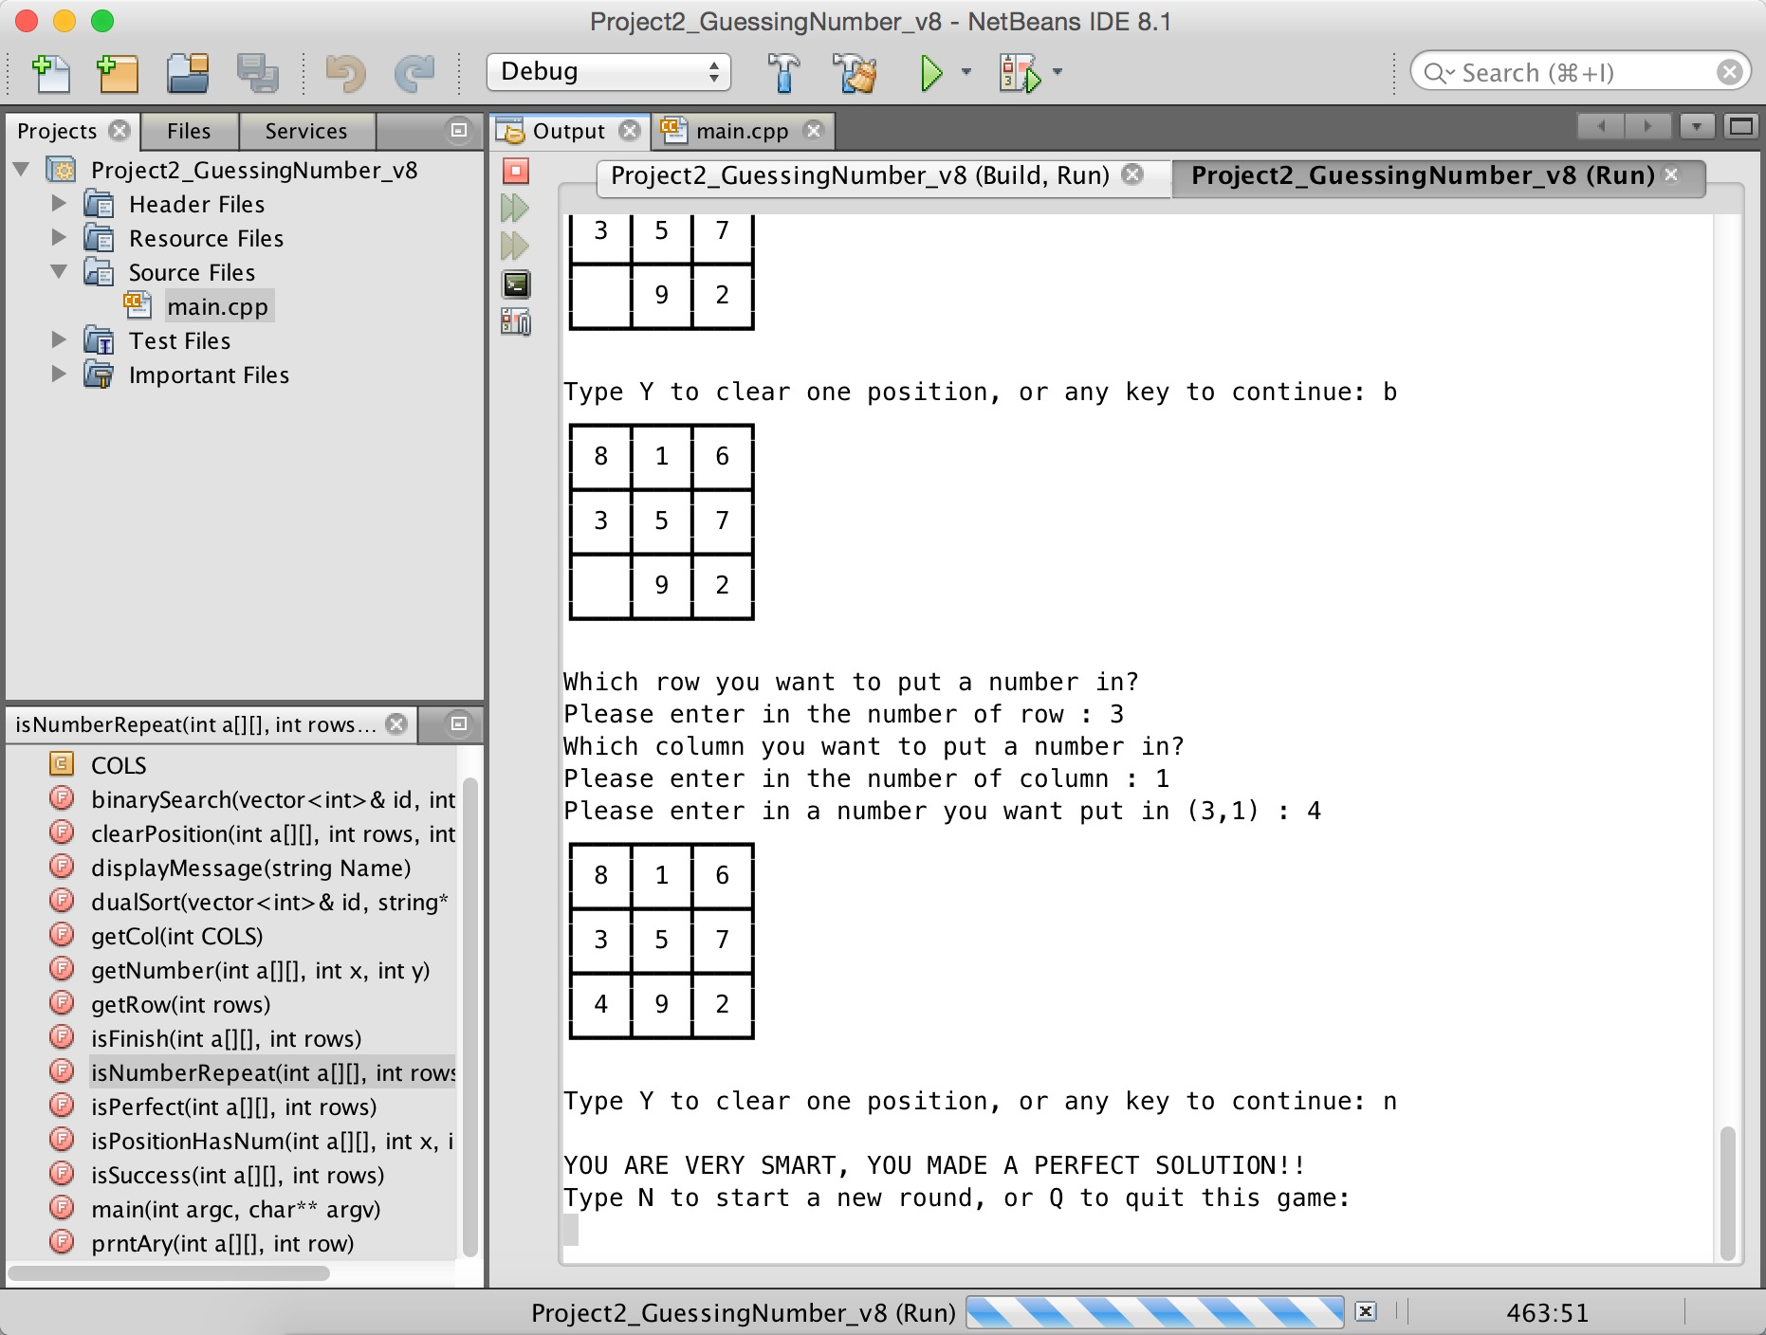
Back Menu

Slide 27
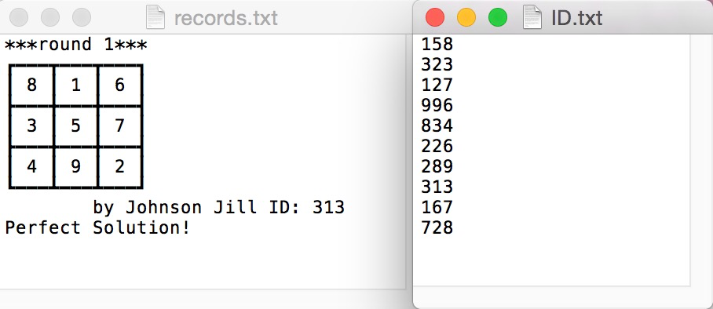
The winning result will be output in record.txt file.
And here are 10 registered ID for tester in ID.txt file
Back Menu

Slide 28
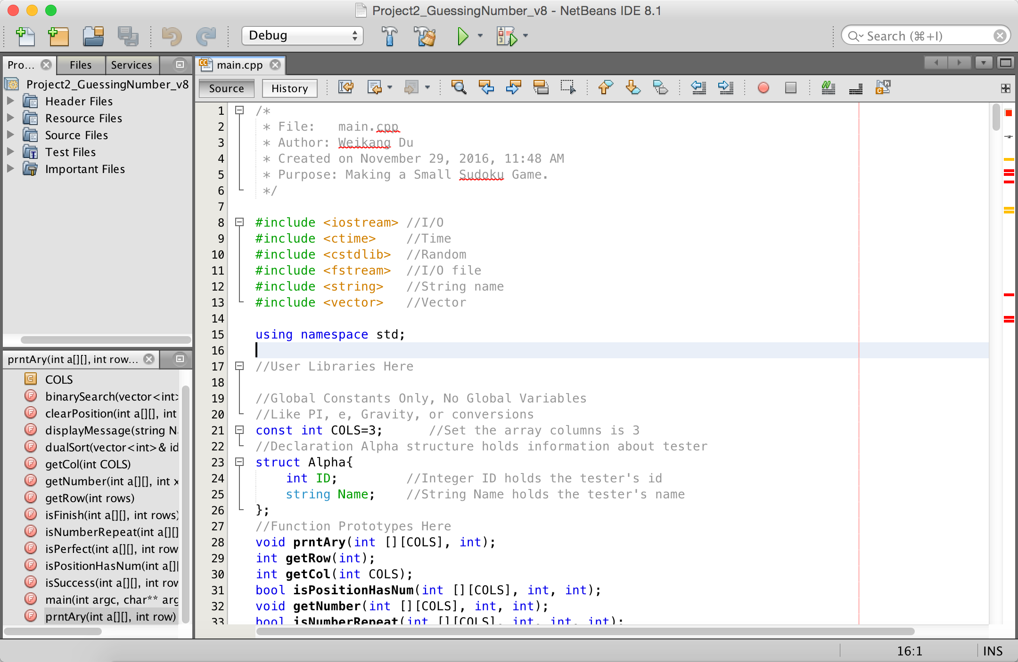
6. Program Code
Back Menu

Slide 29
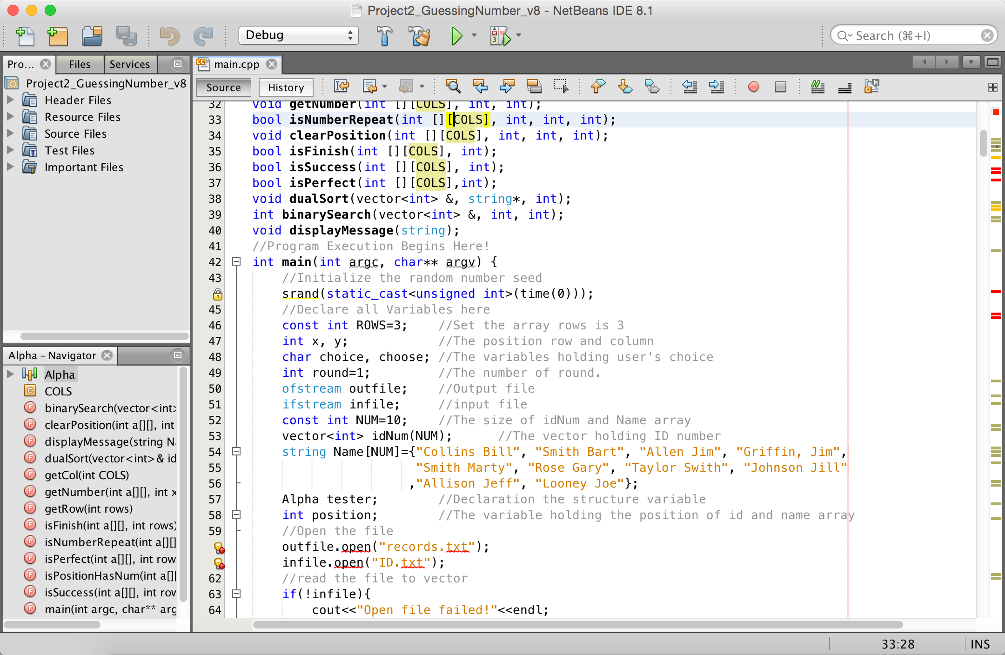
Back Menu

Slide 30
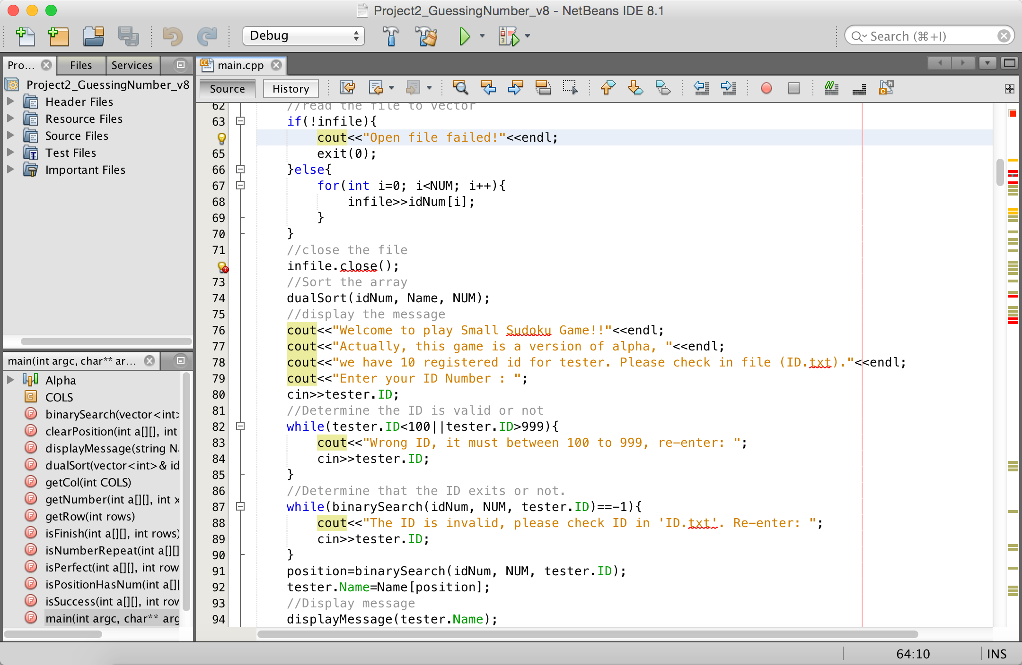
Back Menu

Slide 31
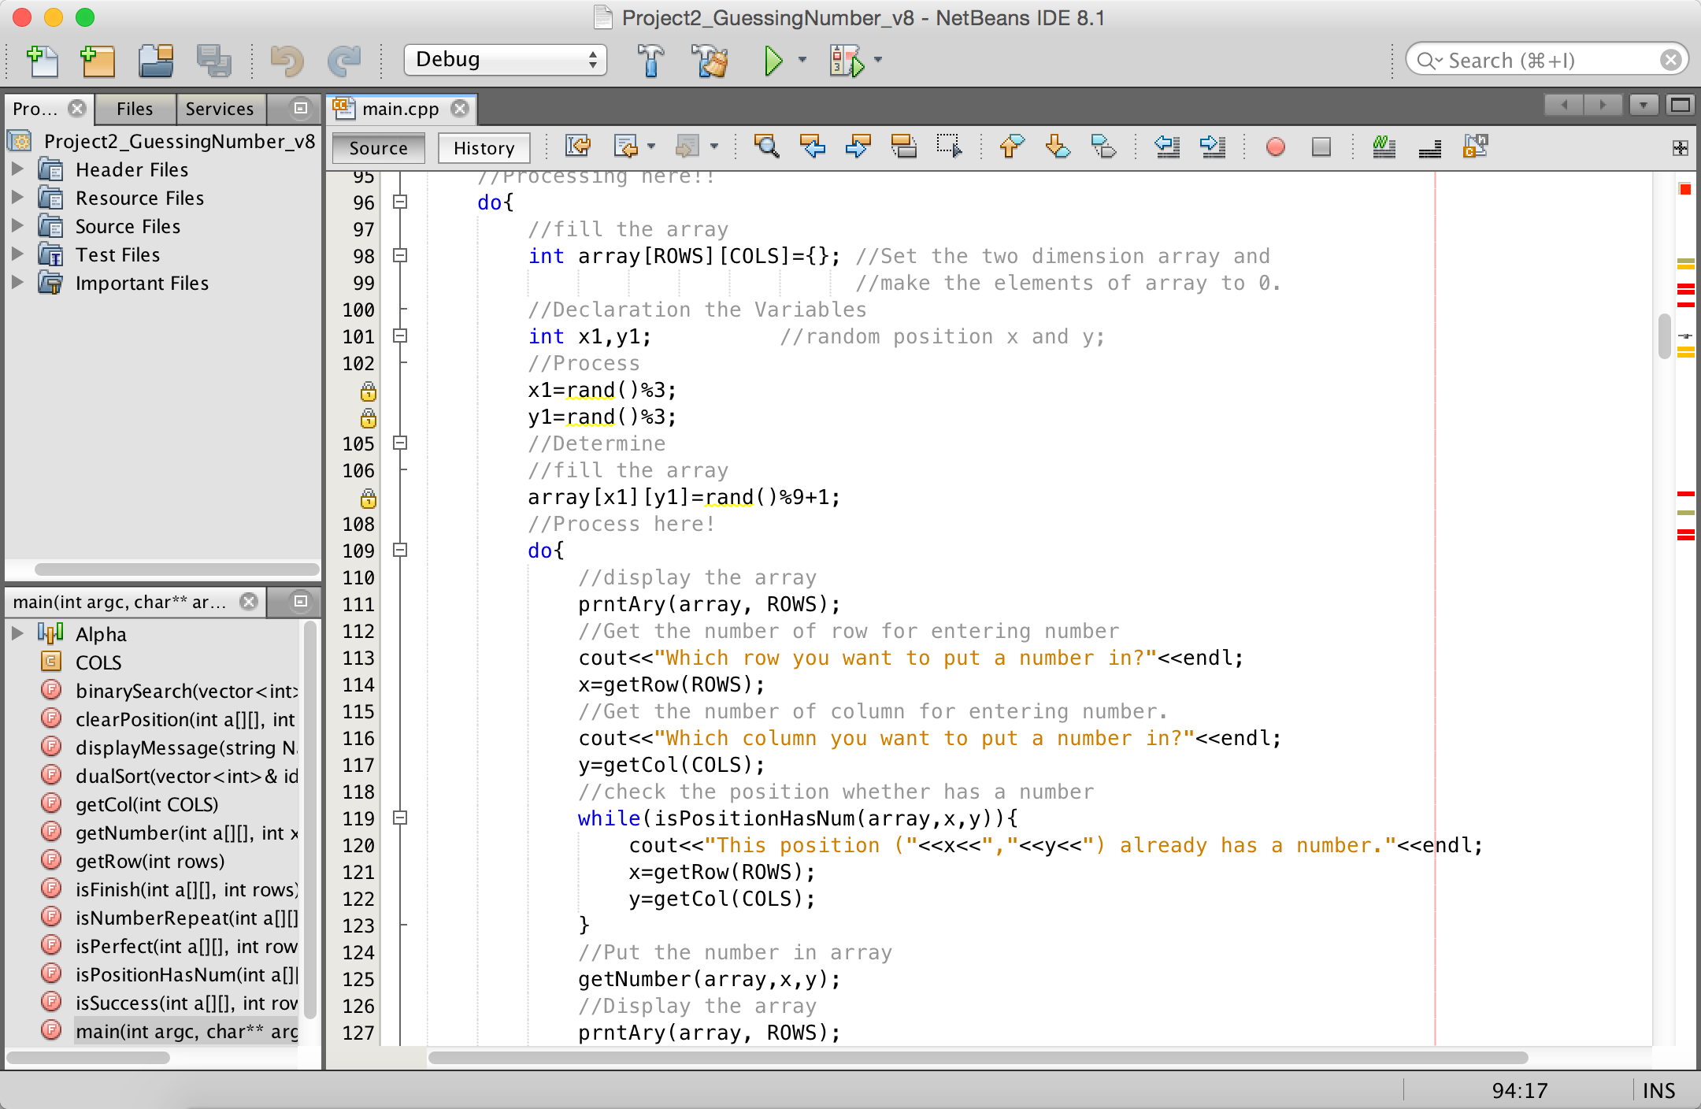
Back Menu

Slide 32
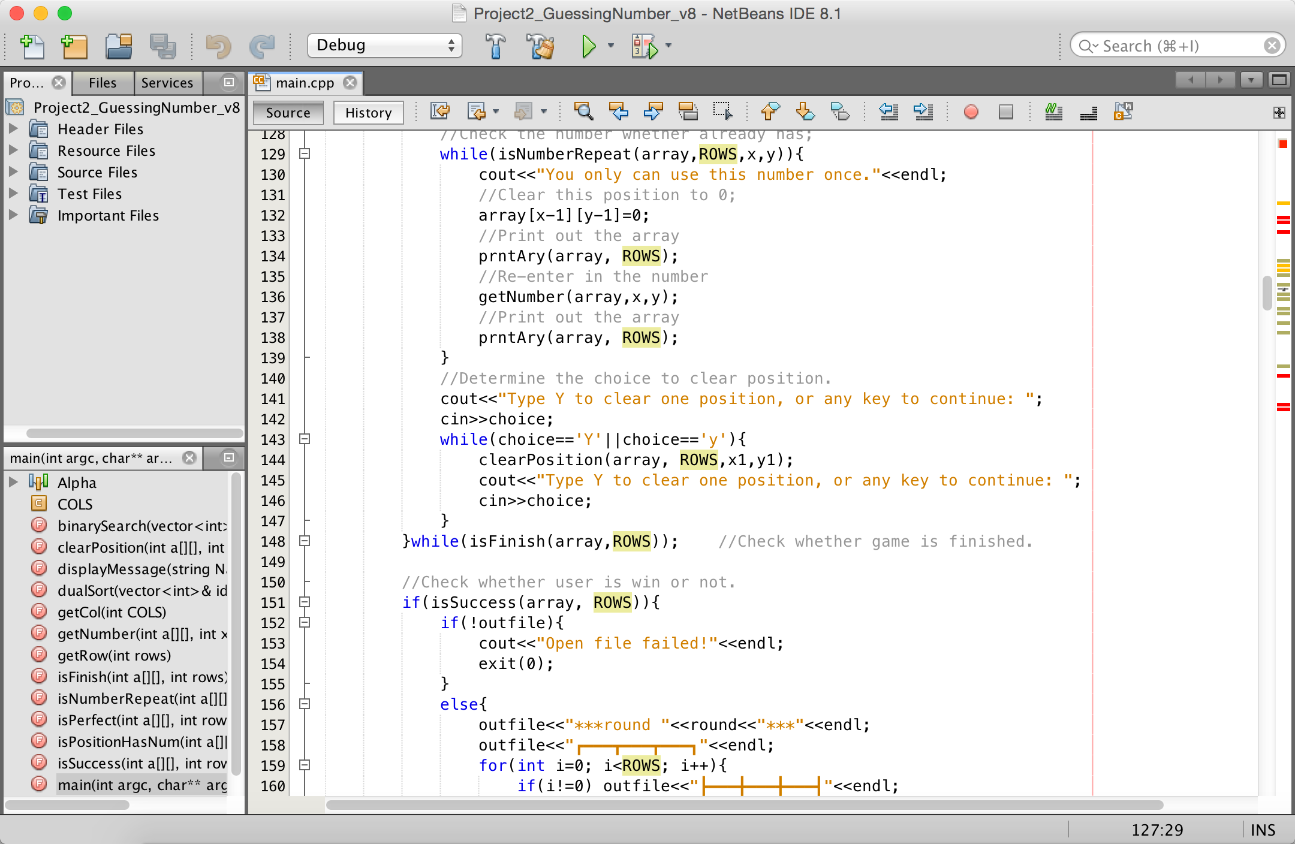
Back Menu

Slide 33
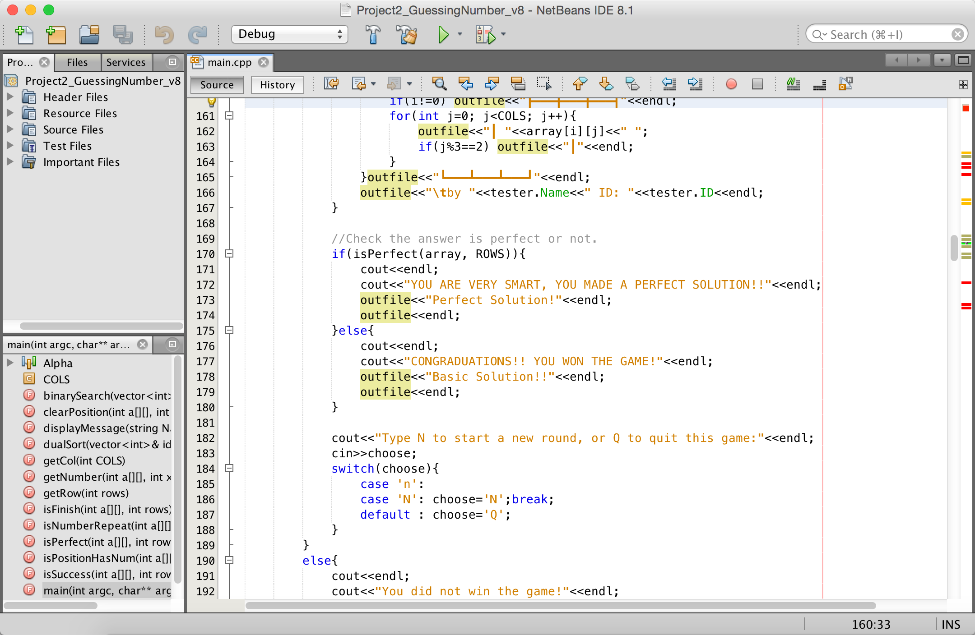
Back Menu

Slide 34
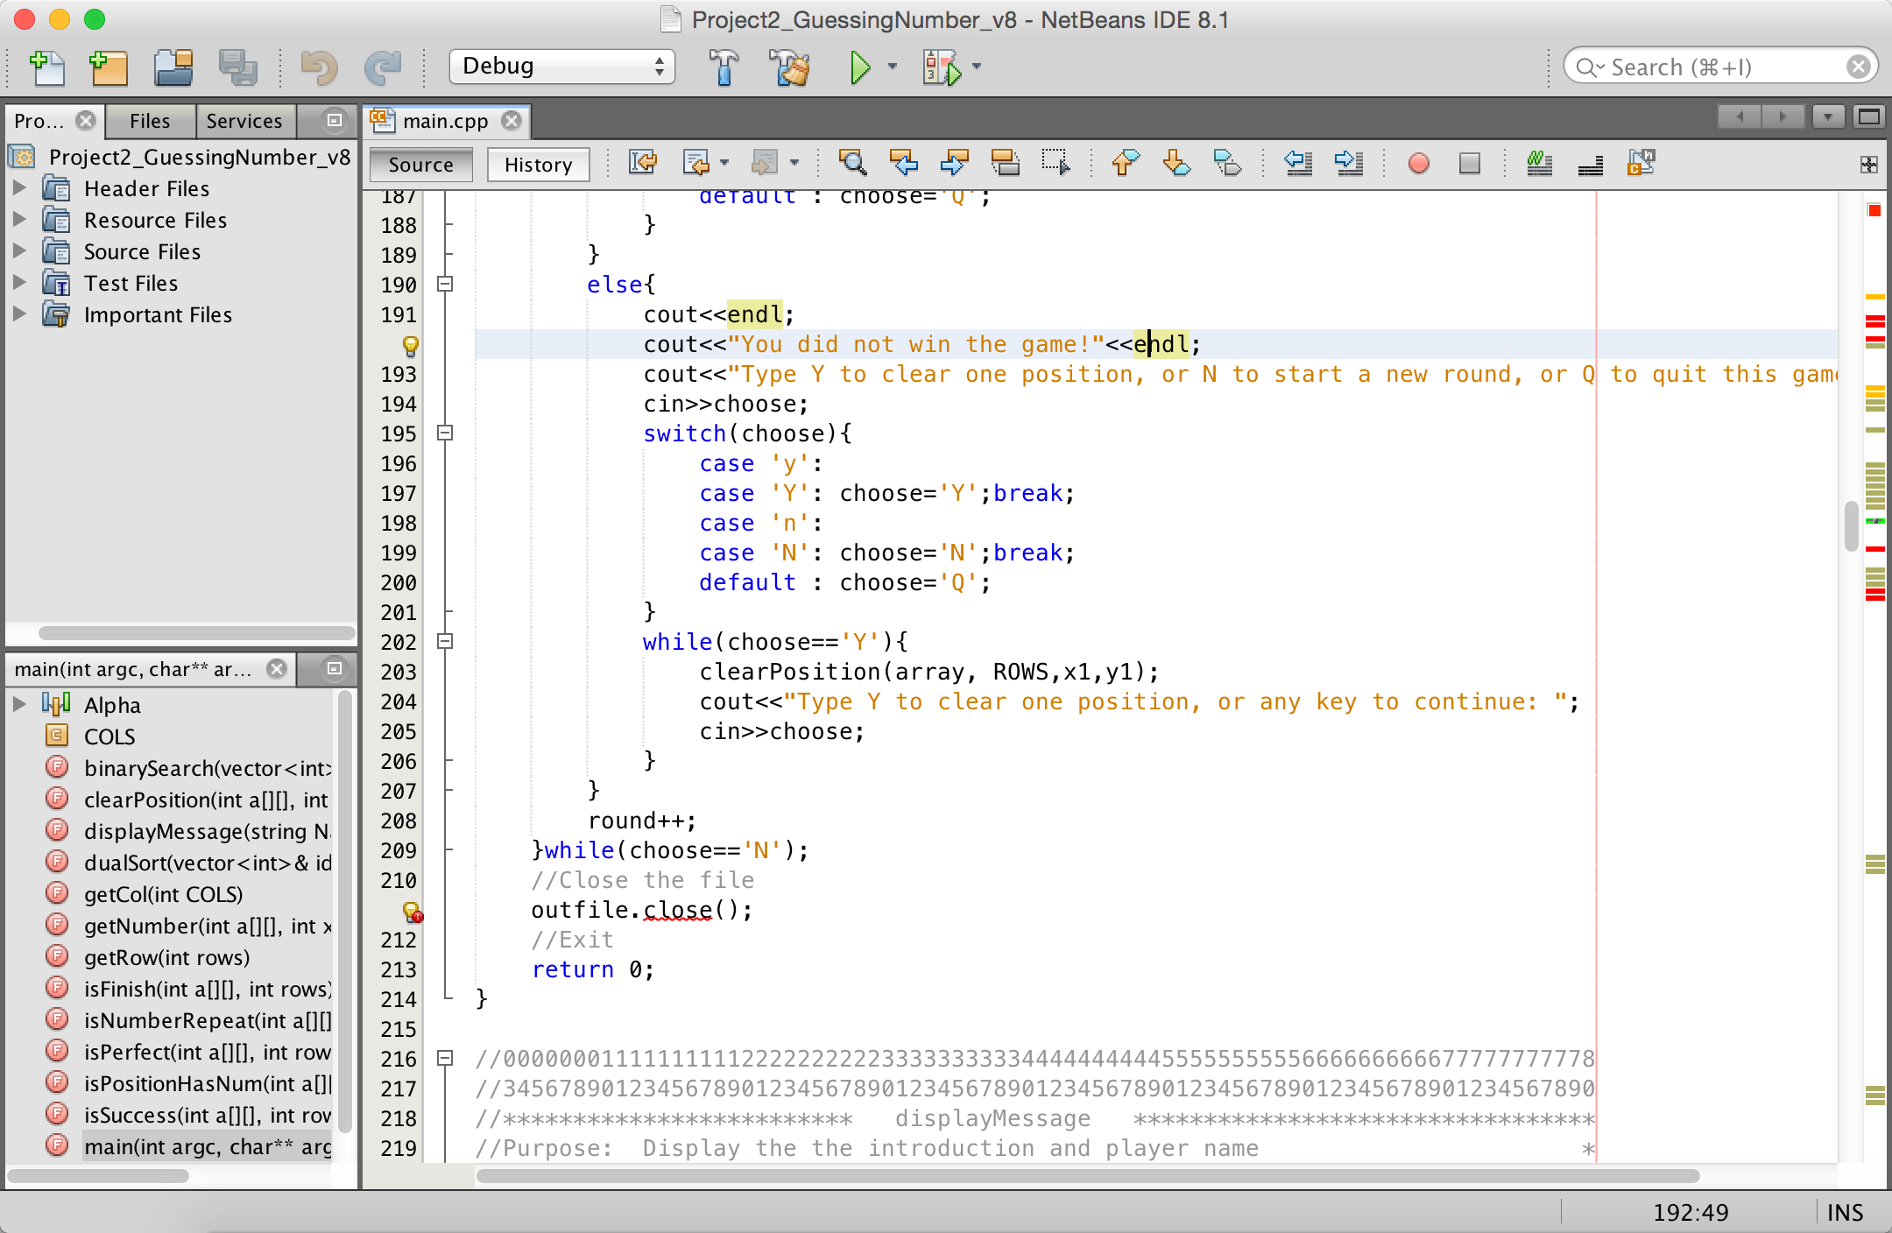
Back Menu

Slide 35
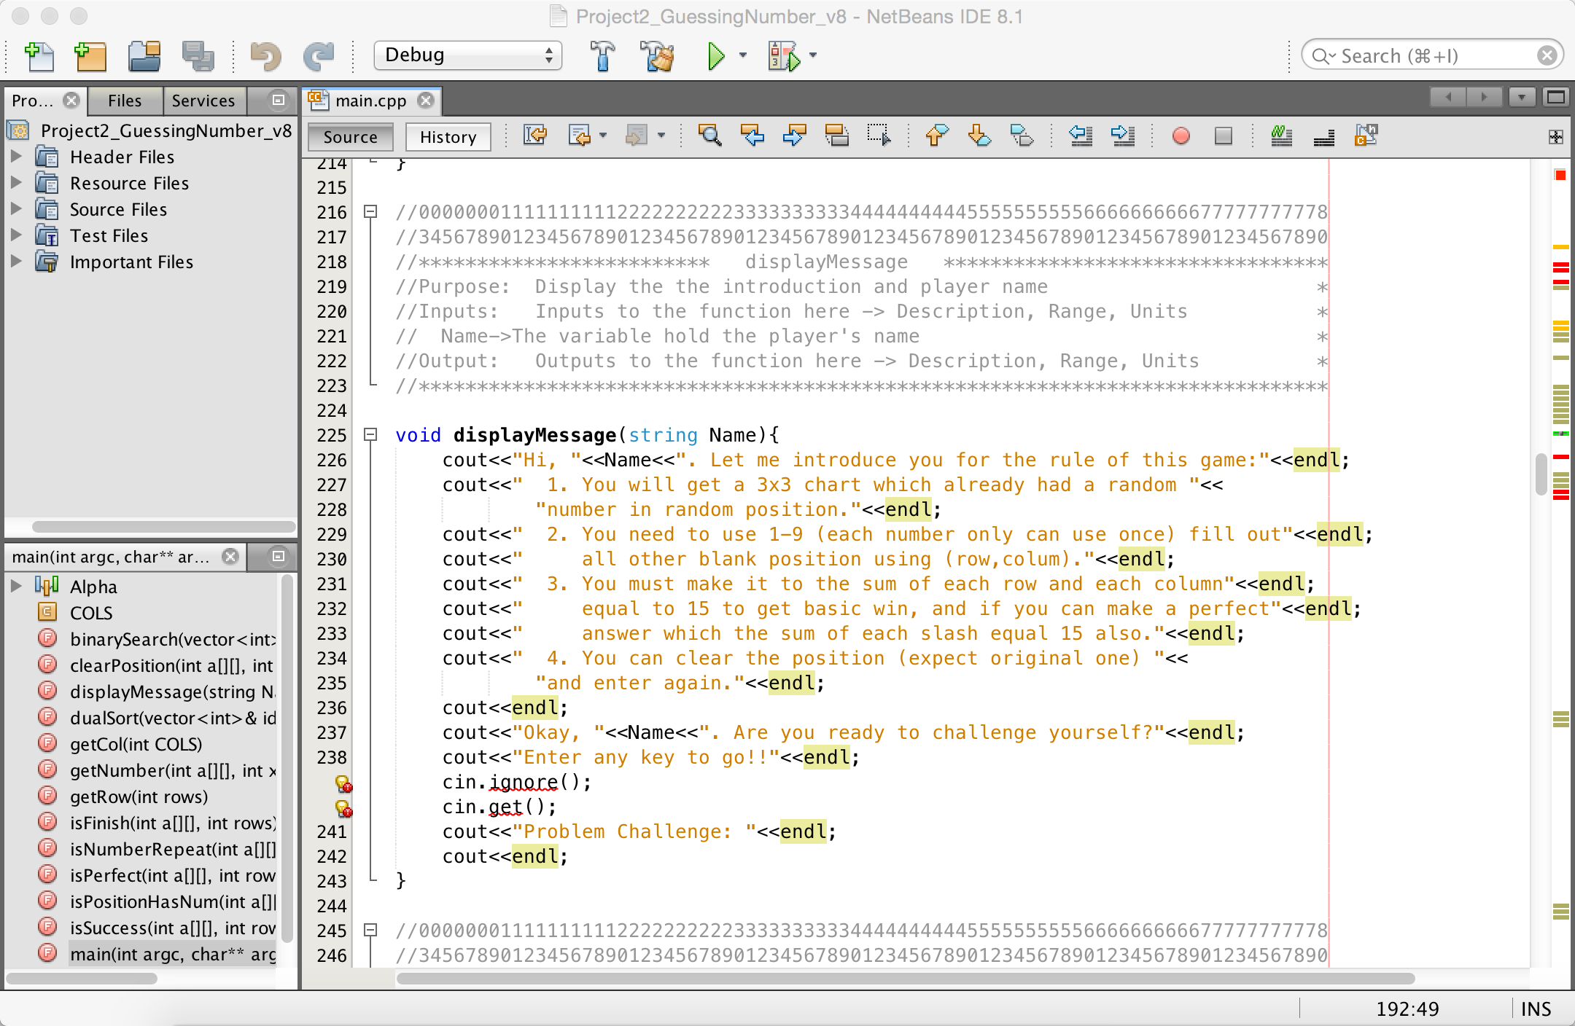
Back Menu

Slide 36
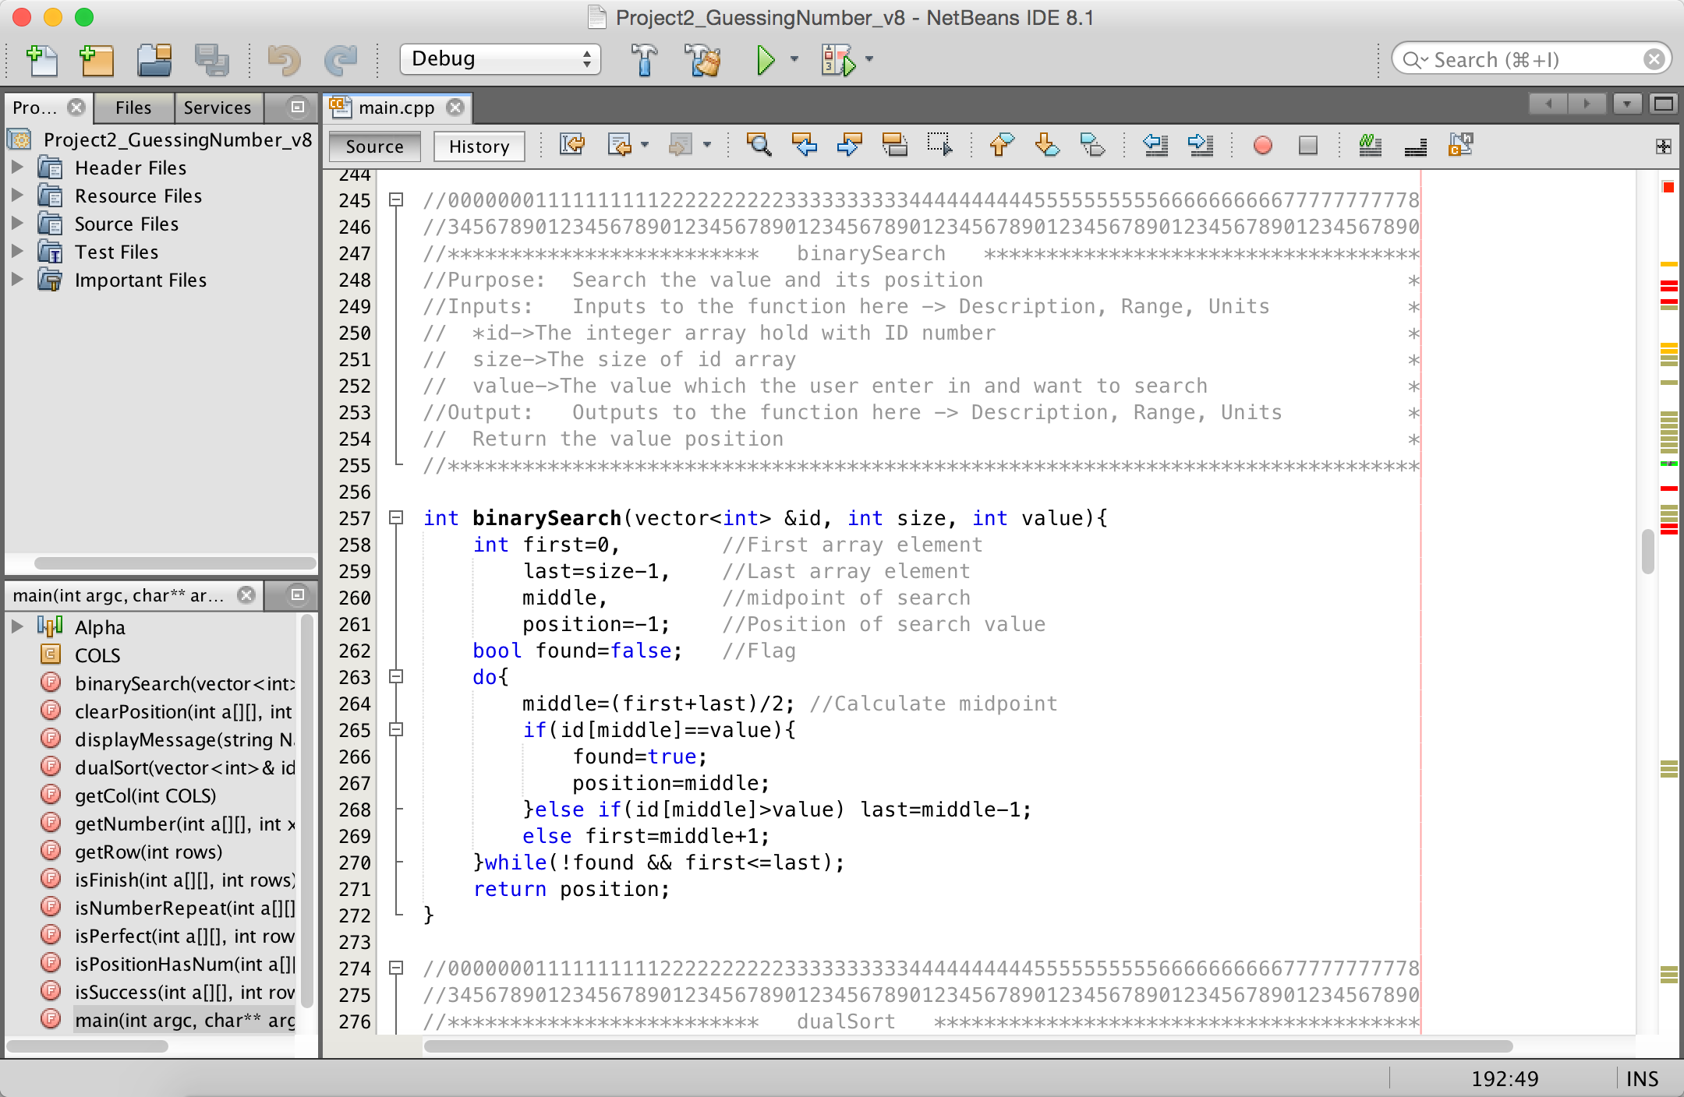
Back Menu

Slide 37
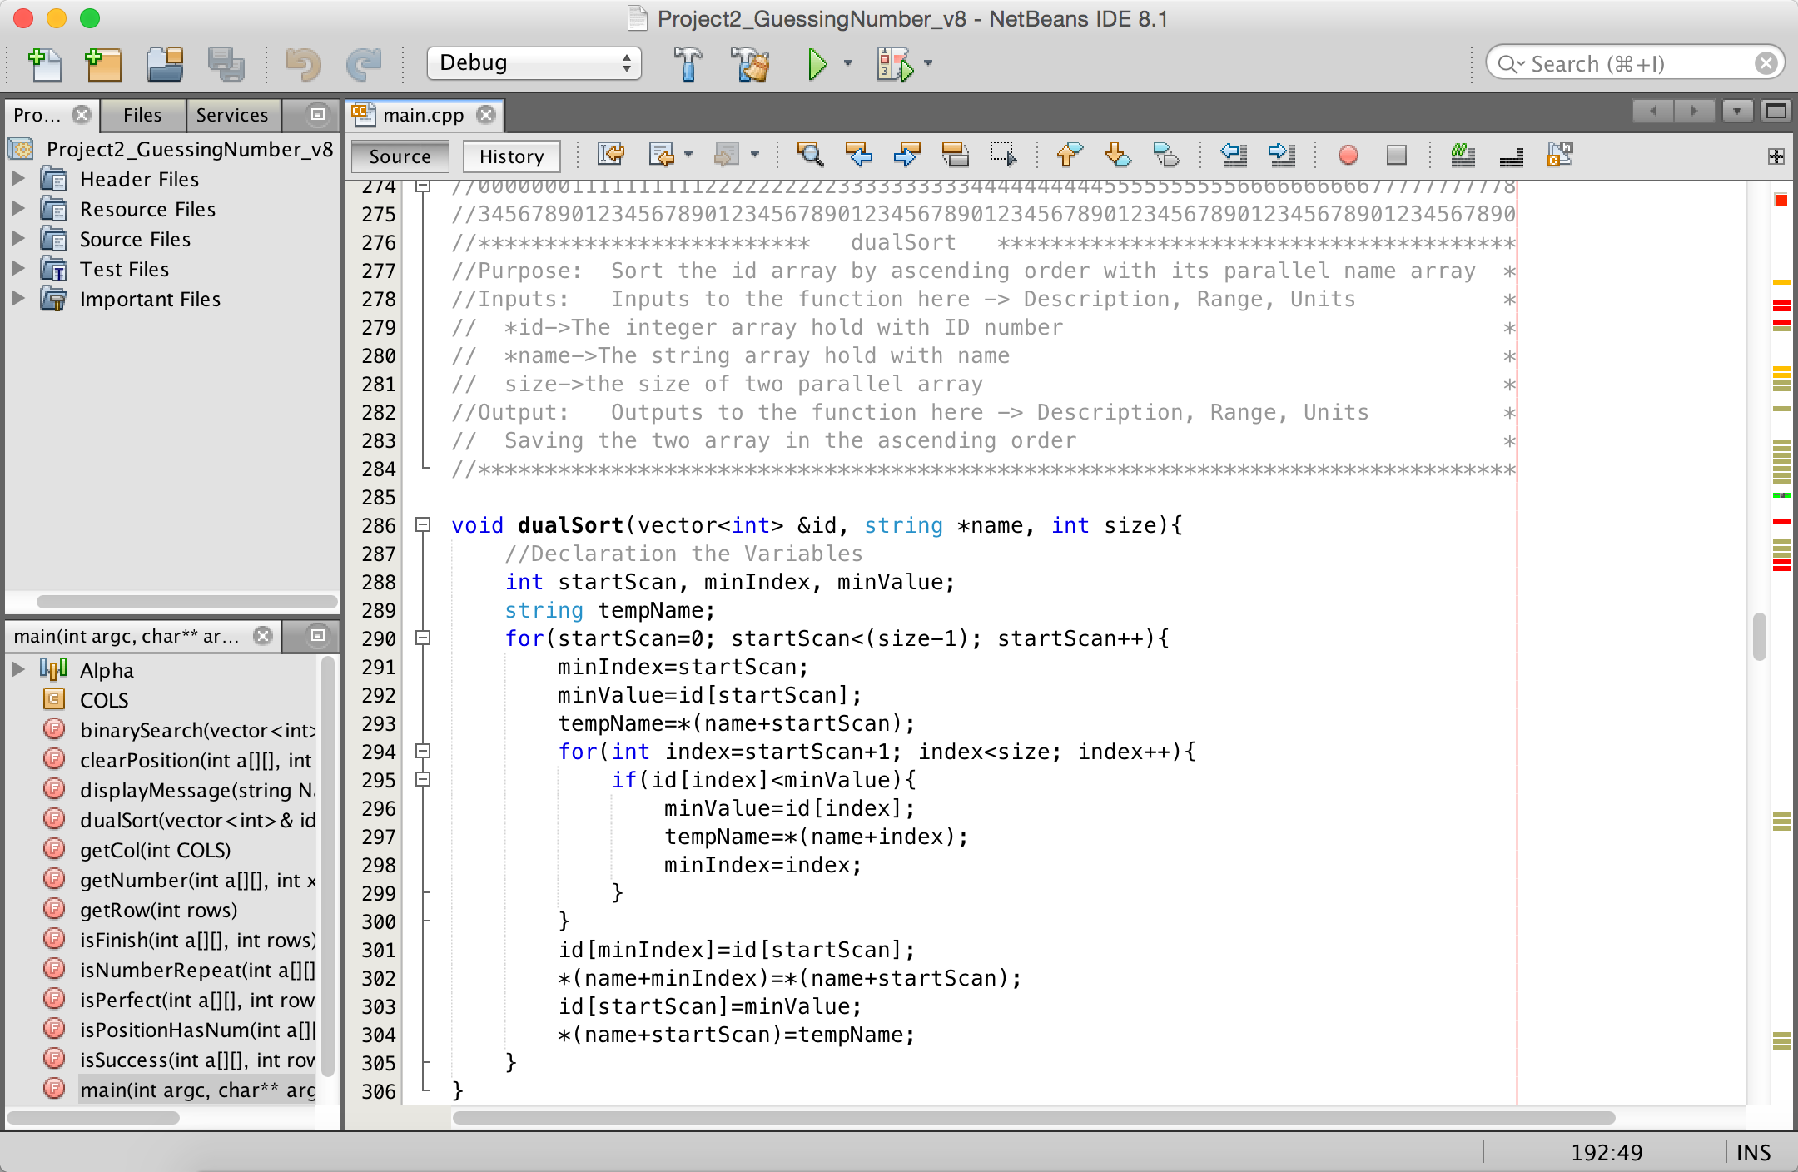
Back Menu

Slide 38
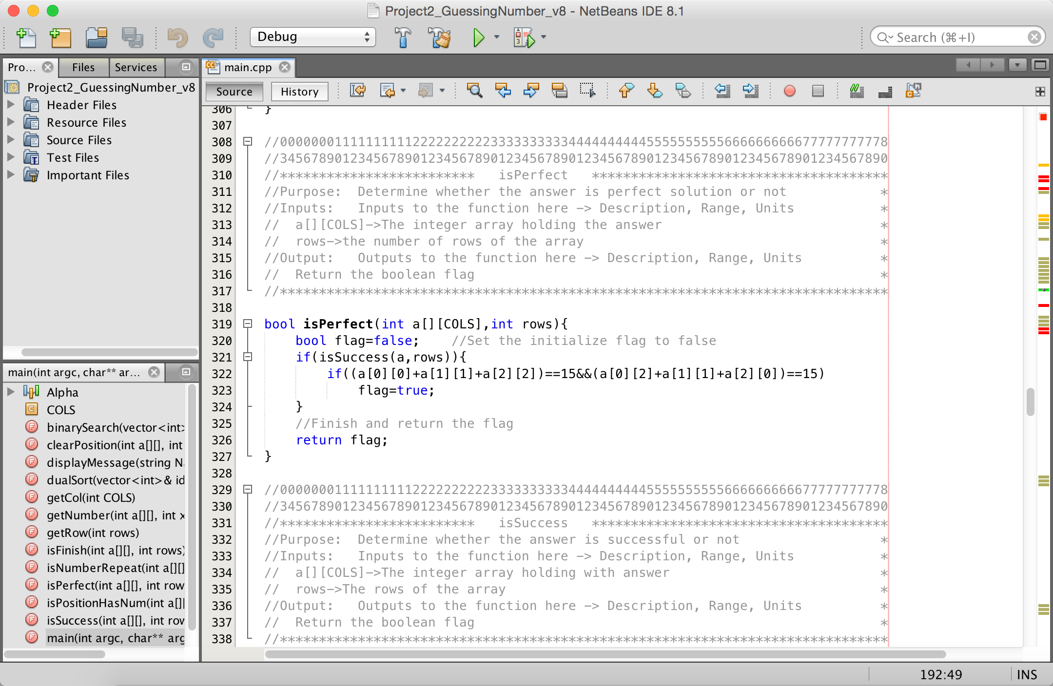
Back Menu

Slide 39

Back Menu

Slide 40

Back Menu

Slide 41

Back Menu

Slide 42

Back Menu

Slide 43

Back Menu

Slide 44

Back Menu

Slide 45

Back Menu

